Slide 1
English Writing Fun
A Mr B Masterclass

Slide 2
English Exam
Essentials:
Tuesday 7 June 2015
9:15 am
2 hours 15 minutes:
1 hour 15 READING
1 hour WRITING

Slide 3
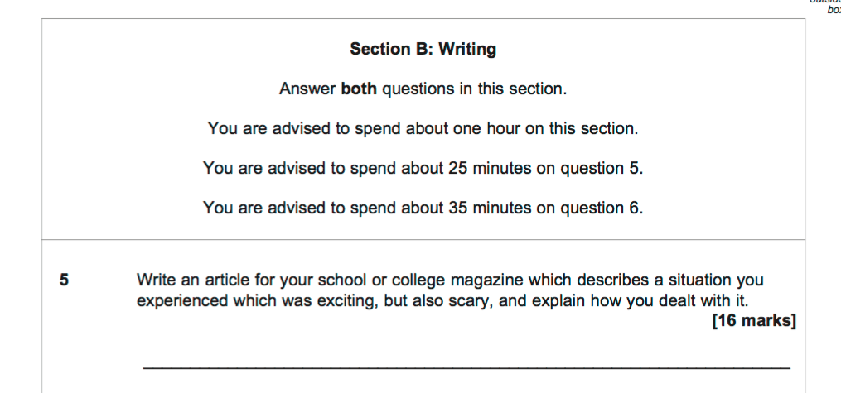

Slide 4
QUESTION 5: Writing to explain or describe (16 marks)
You might be required to write a letter or an article or a blog
25 minutes

Slide 5
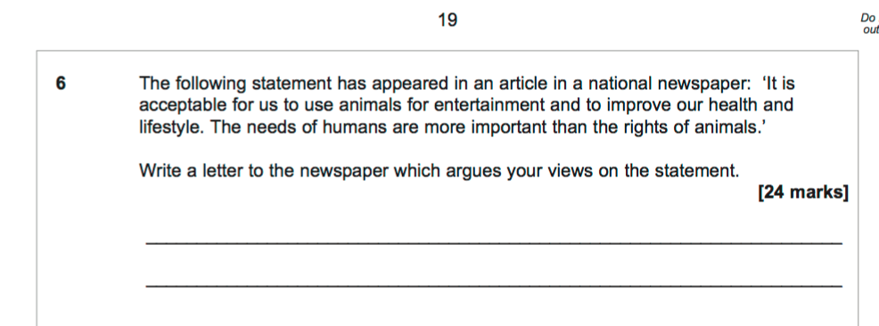
QUESTION 6: Writing to persuade or advise (24 marks)
Write an article (most likely) or blog or speech
You are expressing your opinion
35 minutes

Slide 6
Explain / describe
(25 minutes)

Slide 7
Write a blog describing a place of interest in your area
Write a letter explaining why you disagree with school uniform
Write an article informing people about how young people are often stereotyped in the media
Be clear
Be structured:
5 paragraphs
Be specific – examples
Use short and long sentences
2+ sides

Slide 8
Persuade / argue
(35 mins)

Slide 9
Be opinionated
Be varied: questions, statistics, quotations, stories
Choose interesting words
Use short and long sentences
2½ - 3 sides
Write an article persuading readers that we should take more responsibility for the environment
Write an article arguing that reality television is harmful

Slide 10
Advice
Notes:
A = self-reg; clarity – short and long; and para; 3 – vocab and attitude.

Slide 11
1: Timings: 1 hour
2: Clarity: good writing sounds good – say it in your head
3: Sentences: long and short
4: Words: use words that are vivid, sensuous, but not fancy for the sake of it
5: In task 2, be interesting!
Notes:
A = self-reg; clarity – short and long; and para; 3 – vocab and attitude.

Slide 12
Practice
Notes:
A = self-reg; clarity – short and long; and para; 3 – vocab and attitude.

Slide 16
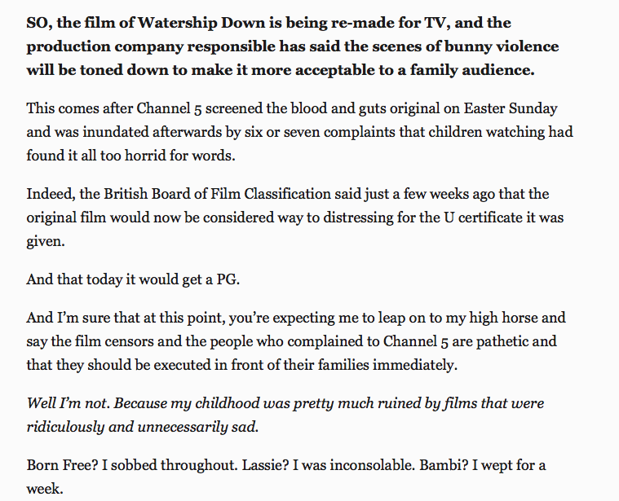

Slide 17
Main Hint: Read it aloud in your head

Slide 18
English Writing Fun
A Mr B Masterclass

