Slide 1
Non-Mathsy Things that May Make a Difference to Maths Attainment
A Conversation:
Geoff Barton (& not Julia Upton)
October 2009

Slide 2
What teachers do
What students do

Slide 3
What teachers do
Teacher talk: questions, thinking time, responding to answers
Using exploratory talk
Illuminating barriers to learning
Using fewer but better questions – inc multi-choice
Teaching memorisation: “How can I help you to remember this?

Slide 4
Using Diagnostic Questions

Slide 5
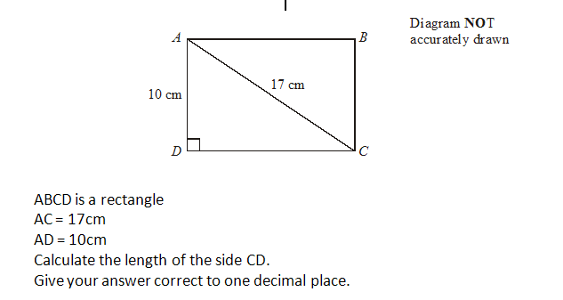

Slide 7
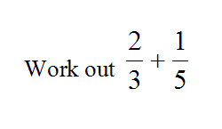
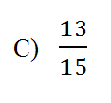
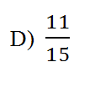

Slide 8
What teachers do
Teacher talk: questions, thinking time, responding to answers
Using exploratory talk
Illuminating barriers to learning
Using multi-choice diagnostic questions
Teaching memorisation: “How can I help you to remember this?

Slide 9
2. What students do
What do students say?
Use intervention pre-questions
Revision carousels based on student need
Some students learn better from ‘non-teachers’
Demonstrate relevance to real life
Articulate the blockages
Create ‘girl security’

Slide 11
4 Key messages …
Work with individuals and genuinely unpick their misconceptions
Don’t just focus on the “C” grade skills – their misunderstandings are often at a more fundamental level: 80% of the questions on the exam are below C grade
Get students confident to “have a go” – the number-phobic but aspirational
Hardworking students often don’t put pen to paper for fear of it being wrong

Slide 12
Non-Mathsy Things that May Make a Difference to Maths Attainment
A Conversation:
Geoff Barton
October 2009

