Slide 1
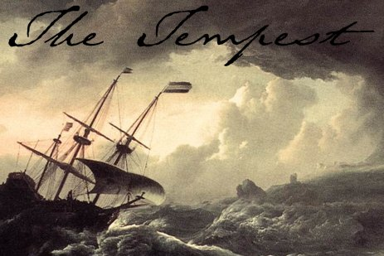
‘O Brave New World’:
Leadership for Literacy
Geoff Barton
Headteacher, King Edward VI School
Download at www.geoffbarton.co.uk (112)
Twitter: @RealGeoffBarton

Slide 2
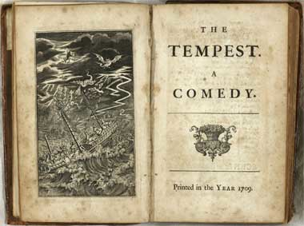
‘O Brave New World’:
Leadership for Literacy
Geoff Barton
Headteacher, King Edward VI School

Slide 3
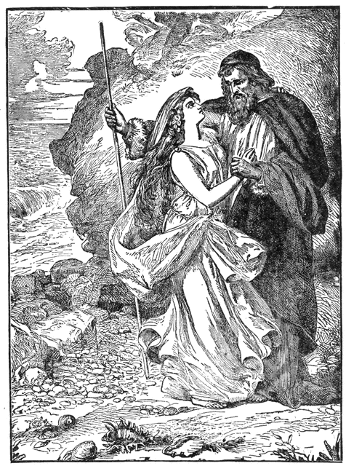
Miranda:
“O brave new world, That has such people in't!”
Prospero:
“Tis new to thee”

Slide 4
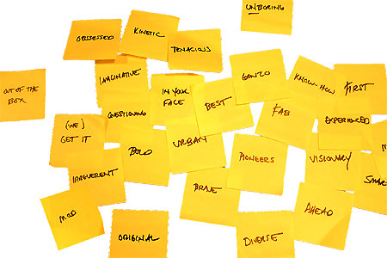
www.geoffbarton.co.uk/teacher-resources (112)

Slide 5
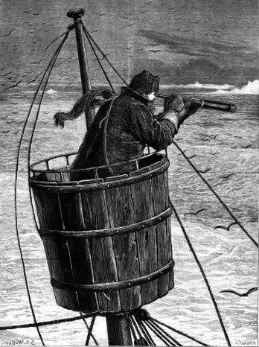
Surveying the landscape
Master:
“We run ourselves aground”

Slide 6
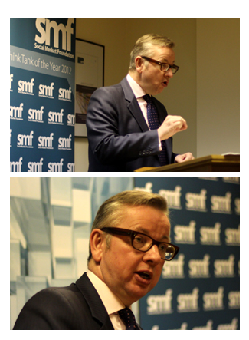
Speech to Social Market Foundation
5 February 2013

Slide 7
“Two particular individuals have influenced me more than any others …”

Slide 8
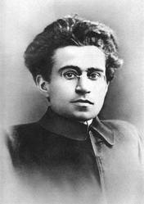

Slide 9
At a tragically early age Jade was diagnosed with cervical cancer. Terminally ill, she had to make plans for her two beloved boys …
She used her money to send them to the most traditional, academically demanding prep school she could find. So they could enjoy the best education reality TV could buy.

Slide 11
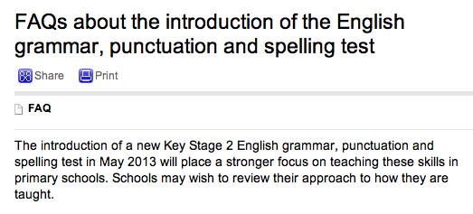

Slide 12
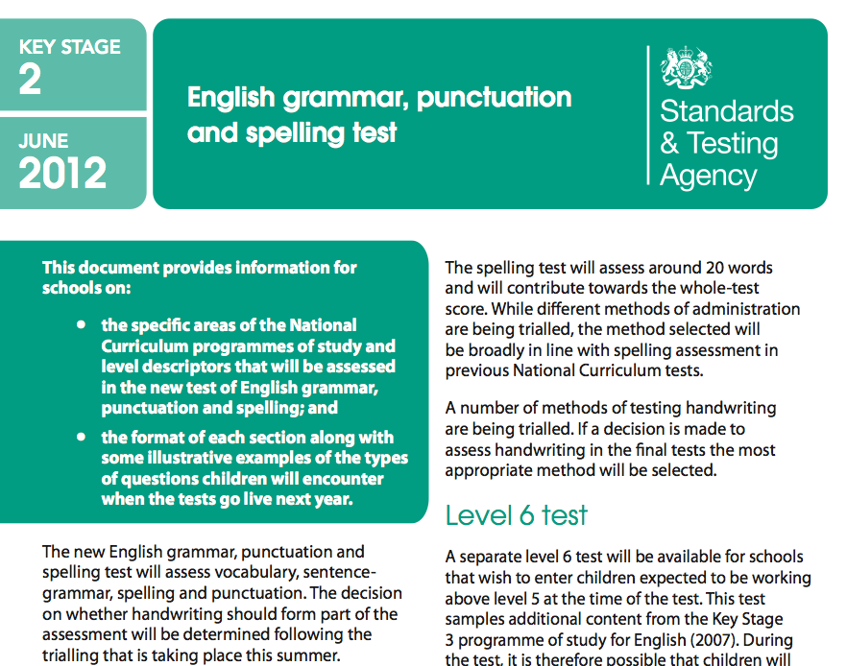

Slide 13
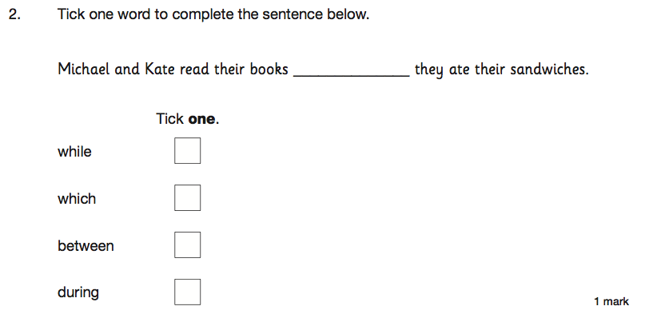

Slide 14
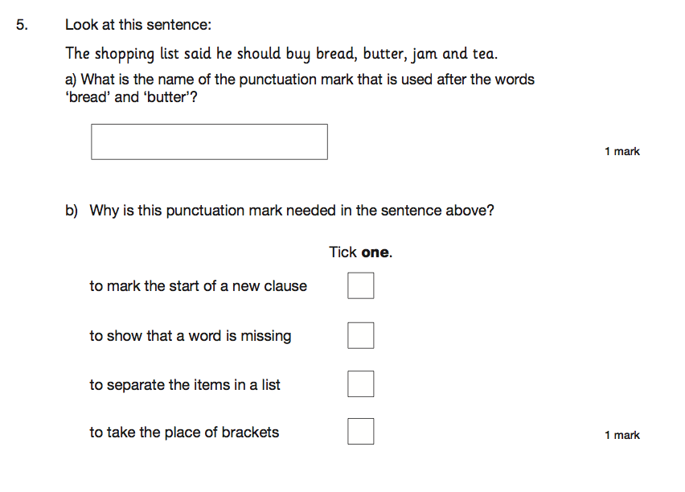

Slide 15
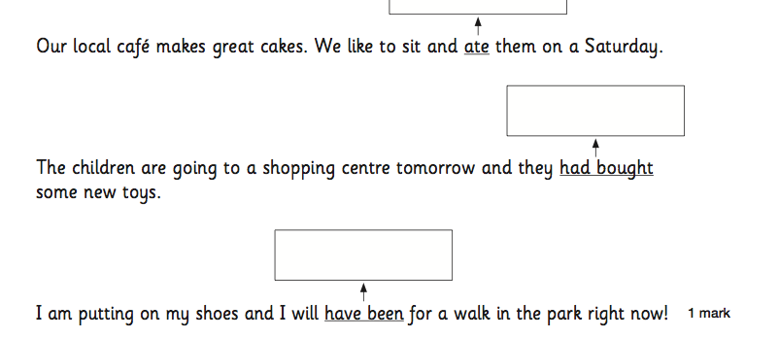

Slide 16
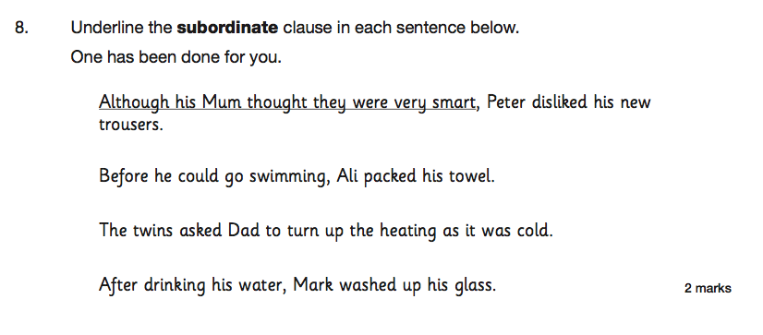

Slide 17
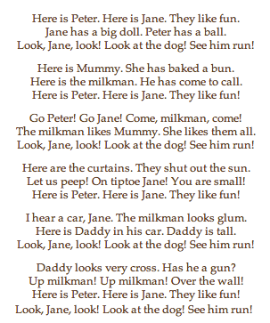
Wendy Cope
Reading Scheme

Slide 18
Unintended consequences

Slide 19
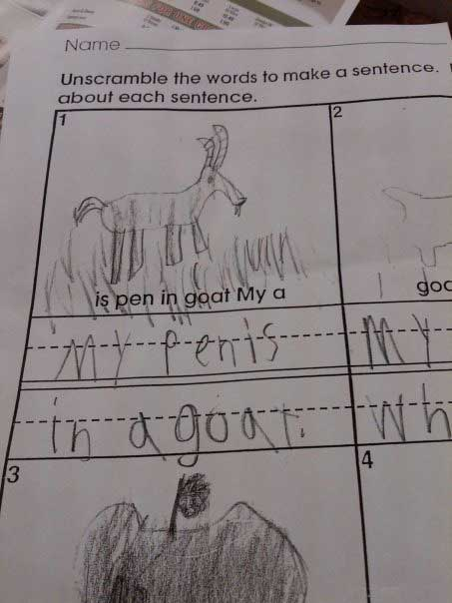

Slide 20
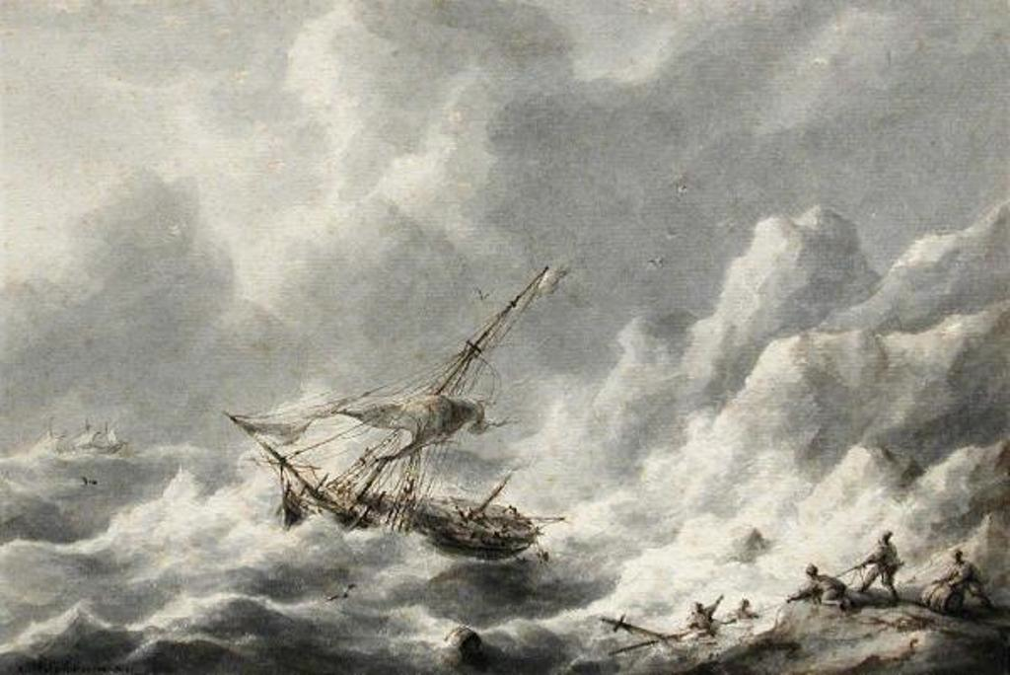

Slide 21
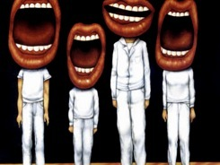
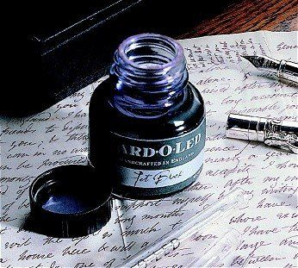
Which bits of literacy make a difference?

Slide 22
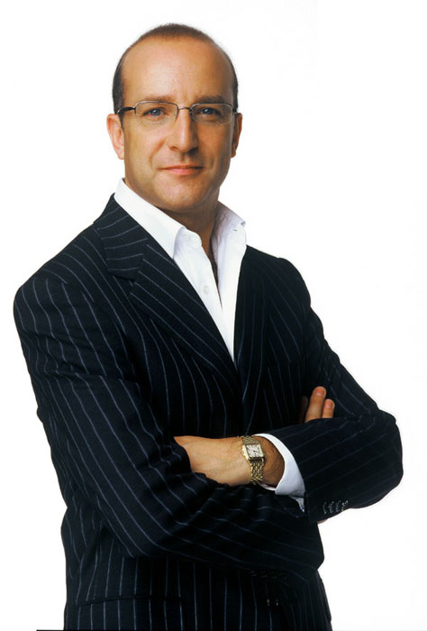
Aims:
I will make you better at READING & WRITING
& SPELLING

Slide 23
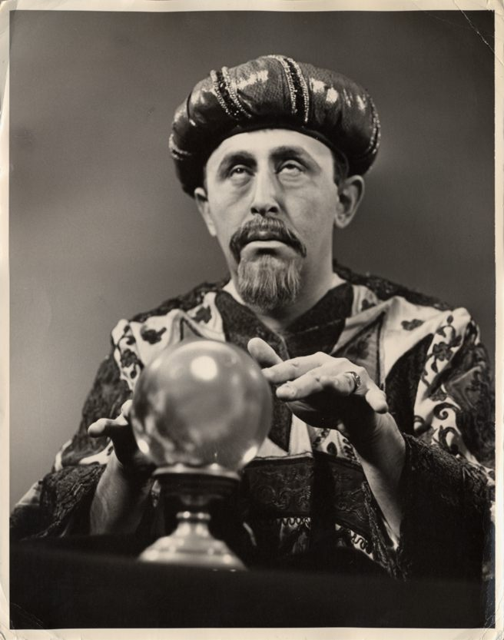
Today’s bonus:
Today I will reveal the secret of literacy

Slide 24
Hypothesis:
Become a Year 11 writer again
… for five minutes

Slide 25
Hypothesis:
Task:
Describe the room we are in

Slide 26
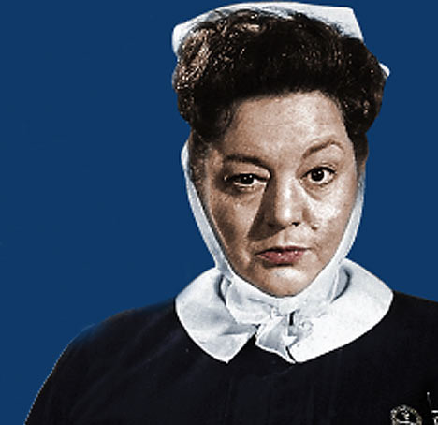
Diagnosis:

Slide 27
Question:
?
Unconfident
Confident
Irrespective of background

Slide 28
Answer:
Teach them

Slide 29
Provocations:
We haven’t done literacy
It’s all about the classroom
Knowledge and instruction may be more important than we realised
Remember the “Matthew Effect”

Slide 30
The Matthew Effect
(Robert K Merton)

Slide 31
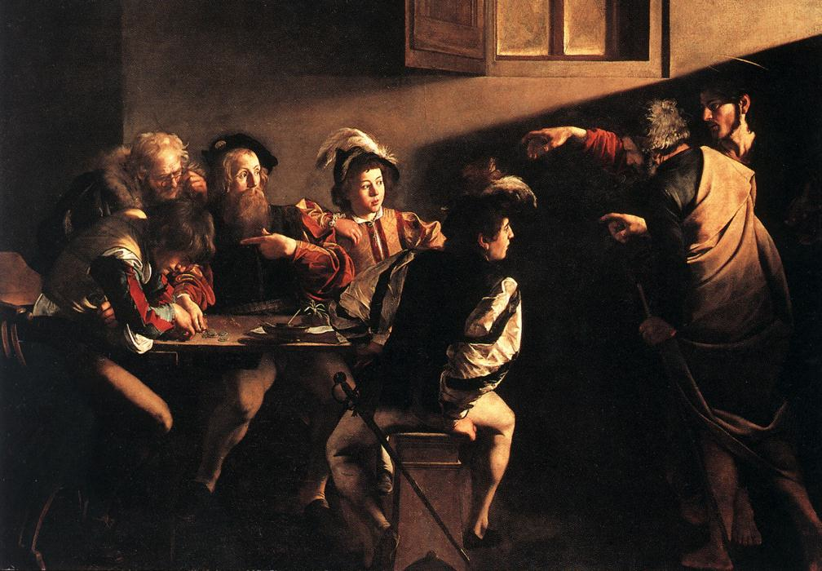

Slide 32
The rich shall get richer and the poor shall get poorer
Matthew 13:12

Slide 33
“The word-rich get richer while the word-poor get poorer” in their reading skills
(CASL)

Slide 34
“While good readers gain new skills very rapidly, and quickly move from learning to read to reading to learn, poor readers become increasingly frustrated with the act of reading, and try to avoid reading where possible”
The Matthew Effect
Daniel Rigney

Slide 35
“Students who begin with high verbal aptitudes find themselves in verbally enriched social environments and have a double advantage.”
The Matthew Effect
Daniel Rigney

Slide 36
“Good readers may choose friends who also read avidly while poor readers seek friends with whom they share other enjoyments”
The Matthew Effect
Daniel Rigney

Slide 37
Stricht’s Law: “reading ability in children cannot exceed their listening ability …”
E.D. Hirsch
The Schools We Need

Slide 38
“Spoken language forms a constraint, a ceiling not only on the ability to comprehend but also on the ability to write, beyond which literacy cannot progress”
Myhill and Fisher

Slide 39
“The children who possess intellectual capital when they first arrive at school have the mental scaffolding and Velcro to catch hold of what is going on, and they can turn the new knowledge into still more Velcro to gain still more knowledge”.
E.D. Hirsch
The Schools We Need

Slide 40
Aged 7:
Children in the top quartile have 7100 words; children in the lowest have around 3000.
The main influence is parents.
DfE Research Unit

Slide 41
The Matthew Effect:
The rich will get richer &
the poor will get poorer

Slide 42
Hargreaves & Fullan:
Professional Capital
The Literacy Club

Slide 43
“Three-quarters of teachers who demonstrated sustained commitment said that good leadership helped them sustain their commitment over time. Better leaders produce better teachers”
The Literacy Club

Slide 44
Ben Levin:
How to Improve 5000 Schools
The Literacy Club

Slide 45
“If you scout out the best professors, their courses will be interesting even if you start out not caring about the subject … curriculum matters less than quality of teaching”
The Literacy Club

Slide 46
The
view
of literacy

Slide 47
✗ May be mechanistic and superficial
✔ Yet may be very helpful

Slide 48
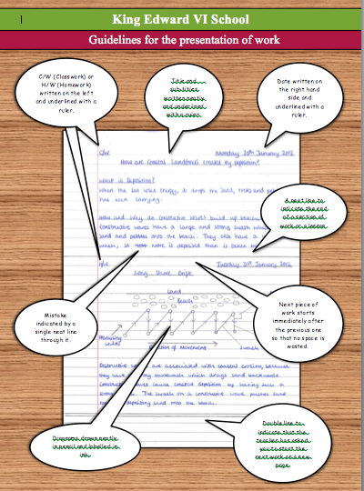

Slide 50
Are key terms and vocabulary clear and explored with pupils to ensure that they recognise and understand them? Are they related to similar words or the root from which they are derived?
Do teachers identify any particular features of key terms and help pupils with strategies for remembering how to spell them or why they might be capitalised (e.g. ‘Parliament’ in history or citizenship)?
Do teachers remind pupils of important core skills – for example how to skim a text to extract the main elements of its content quickly or to scan a text for information about a key word or topic?

Slide 51
Do teachers make expectations clear before pupils begin a task – for example on the conventions of layout in a formal letter or on the main features of writing persuasively?
Do teachers reinforce the importance of accuracy in spoken or written language – for example, emphasising the need for correct sentence punctuation in one-sentence answers or correcting ‘we was...’ in pupils’ speech?
Do teachers identify when it is important to use standard English and when other registers or dialects may be used – for example, in a formal examination answer and when recreating dialogue as part of narrative writing?

Slide 52
Do teachers help pupils with key elements of literacy as they support them in lessons? Do they point out spelling, grammar or punctuation issues as they look at work around the class?
Does teachers’ marking support key literacy points? For example, are key subject terms always checked for correct spelling? Is sentence punctuation always corrected?

Slide 53
5 key ingredients
Then teach you something
Then reflection

Slide 54
Understand the significance of exploratory talk
Model good talk – eg connectives
Re-think questioning – ‘why & how’, thinking time, and no-hands-up
Consciously vary groupings
Get conversation into the school culture

Slide 55
Talking Point
Understand the significance of exploratory talk
Model good talk – eg connectives
Re-think questioning – ‘why & how’, thinking time, and no-hands-up
Consciously vary groupings
Get conversation into the school culture
Implications in your school?

Slide 56
Teach reading – scanning, skimming, analysis
Read aloud and display
Teach key vocabulary
Demystify spelling
Teach research, not FOFO

Slide 57
DEMO

Slide 58
SKIMMING

Slide 59
The climate of the Earth is always changing. In the past it has altered as a result of natural causes. Nowadays, however, the term climate change is generally used when referring to changes in our climate which have been identified since the early part of the 1900's . The changes we've seen over recent years and those which are predicted over the next 80 years are thought to be mainly as a result of human behaviour rather than due to natural changes in the atmosphere.

Slide 60
The best treatment for mouth ulcers. Gargle with salt water. You should find that it works a treat. Salt is cheap and easy to get hold of and we all have it at home, so no need to splash out and spend lots of money on expensive mouth ulcer creams.

Slide 61
Lexical v Grammatical Words

Slide 62
Urquhart castle is probably one of the most picturesquely situated castles in the Scottish Highlands. Located 16 miles south-west of Inverness, the castle, one of the largest in Scotland, overlooks much of Loch Ness. Visitors come to stroll through the ruins of the 13th-century castle because Urquhart has earned the reputation of being one of the best spots for sighting Loch Ness’s most famous inhabitant.

Slide 63
Urquhart castle is probably one of the most picturesquely situated castles in the Scottish Highlands. Located 16 miles south-west of Inverness, the castle, one of the largest in Scotland, overlooks much of Loch Ness. Visitors come to stroll through the ruins of the 13th-century castle because Urquhart has earned the reputation of being one of the best spots for sighting Loch Ness’s most famous inhabitant.

Slide 64
Urquhart castle is probably one of the most picturesquely situated castles in the Scottish Highlands. Located 16 miles south-west of Inverness, the castle, one of the largest in Scotland, overlooks much of Loch Ness. Visitors come to stroll through the ruins of the 13th-century castle because Urquhart has earned the reputation of being one of the best spots for sighting Loch Ness’s most famous inhabitant.

Slide 65
Urquhart castle is probably one of the most picturesquely situated castles in the Scottish Highlands. Located 16 miles south-west of Inverness, the castle, one of the largest in Scotland, overlooks much of Loch Ness. Visitors come to stroll through the ruins of the 13th-century castle because Urquhart has earned the reputation of being one of the best spots for sighting Loch Ness’s most famous inhabitant.

Slide 66
Urquhart castle is probably one of the most picturesquely situated castles in the Scottish Highlands. Located 16 miles south-west of Inverness, the castle, one of the largest in Scotland, overlooks much of Loch Ness. Visitors come to stroll through the ruins of the 13th-century castle because Urquhart has earned the reputation of being one of the best spots for sighting Loch Ness’s most famous inhabitant.

Slide 67
SCANNING

Slide 68
Where did the first cell phones begin?
Name 2 other features that started to be included in phones
Why are cell phones especially useful in some countries?

Slide 69
Where begin?
Two features?
Some countries?
Cellular telephones
The first cellular telephone system began operation in Tokyo in 1979, and the first U.S. system began operation in 1983 in Chicago. A camera phone is a cellular phone that also has picture taking capabilities. Some camera phones have the capability to send these photos to another cellular phone or computer. Advances in digital technology and microelectronics has led to the inclusion of unrelated applications in cellular telephones, such as alarm clocks, calculators, Internet browsers, and voice memos for recording short verbal reminders, while at the same time making such telephones vulnerable to certain software viruses. In many countries with inadequate wire-based telephone networks, cellular telephone systems have provided a means of more quickly establishing a national telecommunications network.

Slide 70
RESEARCH SKILLS

Slide 71
Research the life of
Martin Luther King

Slide 72
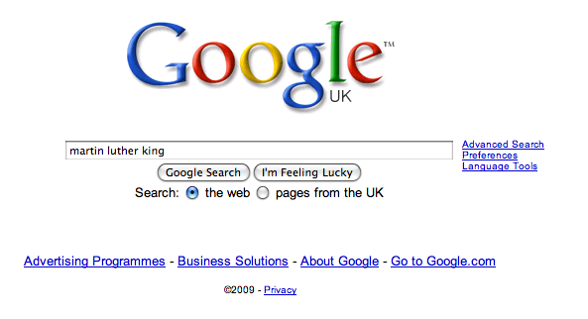

Slide 79
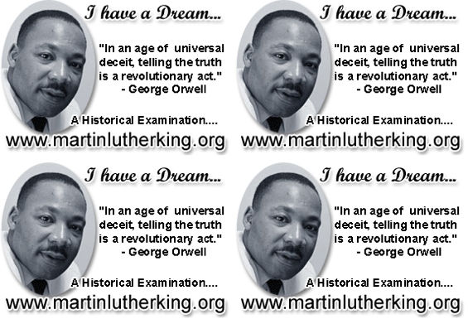

Slide 80
DEMYSTIFYING
SPELLING
3
Notes:
7 spellings: Government – February – parliament – separate – believe – necessary - accommodation

Slide 81
1 - SOUNDS

Slide 82
Government

Slide 83
February

Slide 84
Parliament

Slide 85
2 -VISUALS

Slide 86
Se-para-te
Be-lie-ve

Slide 87
3 - MNEMONICS

Slide 88
necessary

Slide 89
accommodation

Slide 90
Talking Point
Teach reading – scanning, skimming, analysis
Read aloud and display
Teach key vocabulary
Demystify spelling
Teach research, not FOFO
Implications in your school?

Slide 91
Demonstrate writing
Teach composition & planning
Allow oral rehearsal
Short & long sentences
Connectives

Slide 92
Know your connectives
Adding: and, also, as well as, moreover, too
Cause & effect: because, so, therefore, thus, consequently
Sequencing: next, then, first, finally, meanwhile, before, after
Qualifying: however, although, unless, except, if, as long as, apart from, yet
Emphasising: above all, in particular, especially, significantly, indeed, notably
Illustrating: for example, such as, for instance, as revealed by, in the case of
Comparing: equally, in the same way, similarly, likewise, as with, like
Contrasting: whereas, instead of, alternatively, otherwise, unlike, on the other hand

Slide 93
Demonstrate writing
Teach composition & planning
Allow oral rehearsal
Short & long sentences
Connectives

Slide 94
DEMO

Slide 95
Task: write a persuasive article on a controversial subject

Slide 96
Barriers:
Essay-like
Lack of familiarity with genre
Lack of interestingness

Slide 98
MAIN HURDLES
A Thinking of the right word
B Knowing how to get started
C Making it interesting
D Knowing how to link my ideas together
E Trying to make it funny or entertaining
Put these ‘barriers’ in rank order

Slide 99
Are social media sites like Twitter a good thing? Write an article …
Grace Dent, Independent, WEDNESDAY 16 MAY 2012

Slide 100
I've made a decision. From now on, if I need help, I'm heading straight to Twitter. I've tweeted pleas before. I once posted that I needed a job and the same afternoon got commissioned to write an article. But a few weeks ago, I discovered the true benefits of the virtual world. It was election day and on my way back from a lunchtime trip to the launderette I discovered a huge BNP banner had been tied to the lamp post outside my flat. My immediate reaction was to pull it down. The trouble was, I'm short and it was higher than my tallest chair could reach. So I sent out a tweet. Could anyone help me tear down this monstrosity?
Momtaz Begum-Hossain, Guardian, WEDNESDAY 16 MAY 2012

Slide 101
Some people believe far-flung holiday destinations are a waste of money and damage the planet. Write an article …
Jeremy Clarkson, Sunday Times

Slide 102
For your next holiday, why don’t you take all your money and put it on the fire? Then stand in a fridge for a week, beating your children with a baseball bat until their arms and legs break. And then, after you’ve eaten some melted cheese, dislocate your shoulder. If all of this appeals then you are probably one of the 1.3 million British people …
… who go on a skiing holiday at this time of year.

Slide 103
Some people say school uniform is an outdated concept, a waste of time and money. Write a newspaper article saying why school uniform is a good idea.

Slide 105
SUMMARY:
The Secret of Literacy

Slide 106
Stand by …

Slide 107
Ready …?

Slide 108
Tension now intolerable … ?

Slide 109
Well, it’s not literacy …

Slide 110
… it’s making the implicit explicit – and modelling it …

Slide 111
… without which, the rich will get richer & the poor will get poorer

Slide 112
… so we could just call it ‘what great teachers do’

Slide 113
For family & friends:

Slide 114
Epilogue

Slide 115
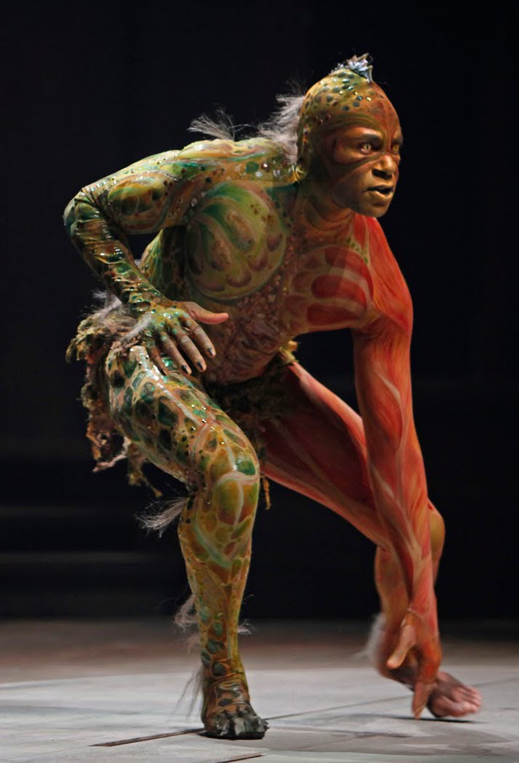
“We are such stuff as dreams are made on, and our little life is rounded with a sleep.”

Slide 116
‘O Brave New World’:
Leadership for Literacy
Geoff Barton
Headteacher, King Edward VI School
Download at www.geoffbarton.co.uk (112)
Twitter: @RealGeoffBarton

