Slide 1
THE HABITS OF ENGLISH
GEOFF BARTON, HEAD
KING EDWARD VI SCHOOL
@RealGeoffBarton
www.geoffbarton.co.uk (Presentation 135)

Slide 2
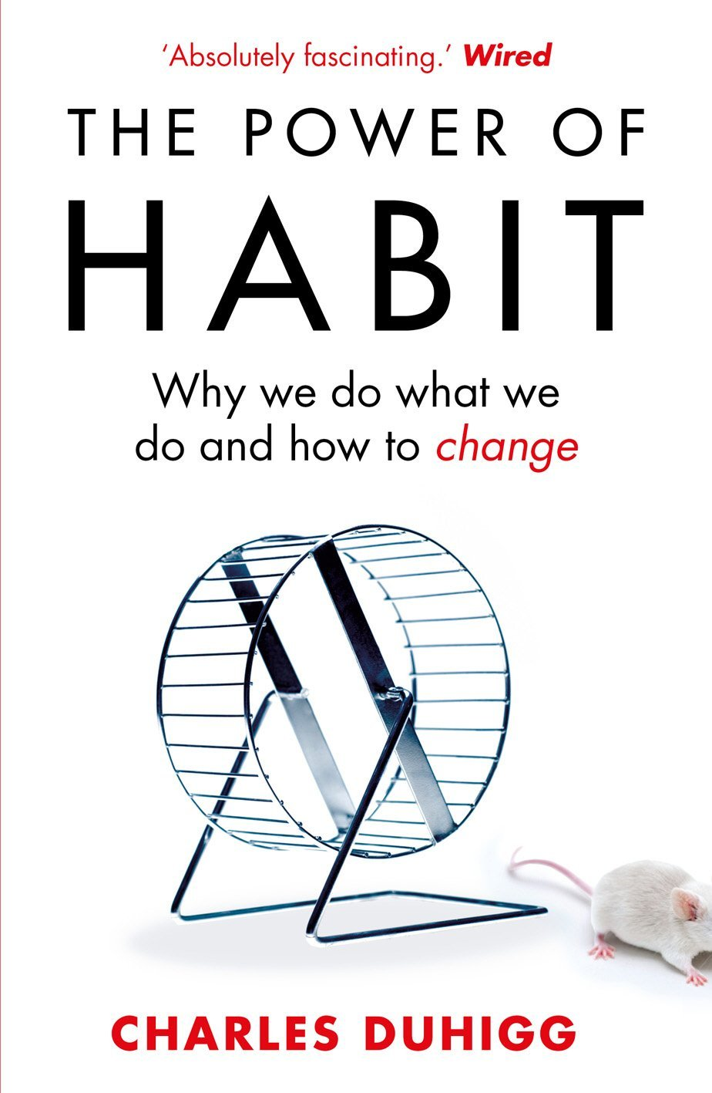
‘More than 40% of the actions people perform each day aren’t decisions but habits …’

Slide 3
‘Habits, scientists say, emerge because the brain is constantly looking for ways to save effort’

Slide 4
‘That’s why signing kids up for piano lessons or sports is so important. It has nothing to do with creating a good musician or a five year-old soccer star’

Slide 5
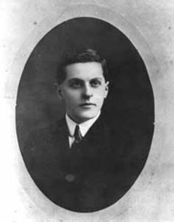
“The limits of my language mean the limits of my world”
Ludwig Wittgenstein

Slide 6
Describe the room we are in

Slide 7
Q1 (of 2):
How did you approach the task?

Slide 8
Q2:
As teacher, what language knowledge could I have taught you to help you write better?

Slide 9
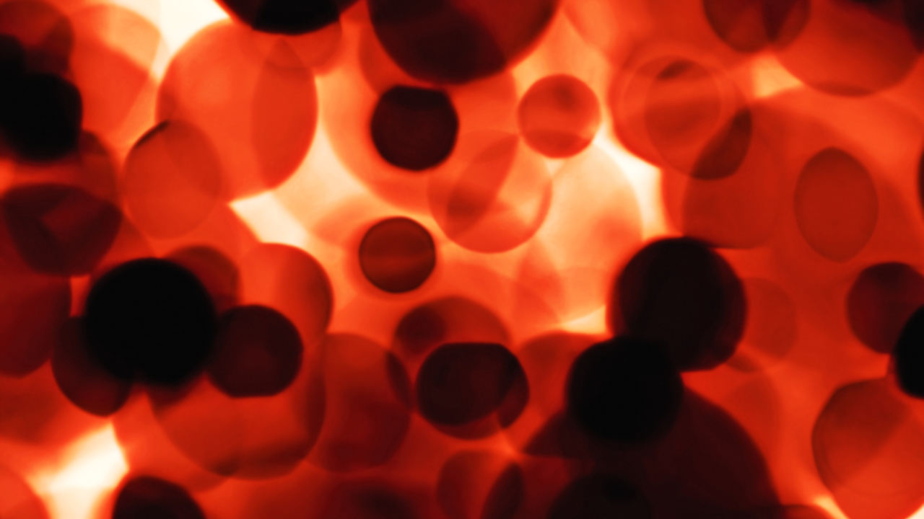
Into the bloodstream:
1 LINGUISTIC RICHNESS
2 PLAYFULNESS
3 RESILIENCE
4 METALANGUAGE
5 SELF-REGULATION

Slide 10
Into the bloodstream:
LINGUISTIC RICHNESS

Slide 11
What if Jane Austen was rewritten by Dylan Thomas?
Notes:
Necessary; accommodation; February;

Slide 12
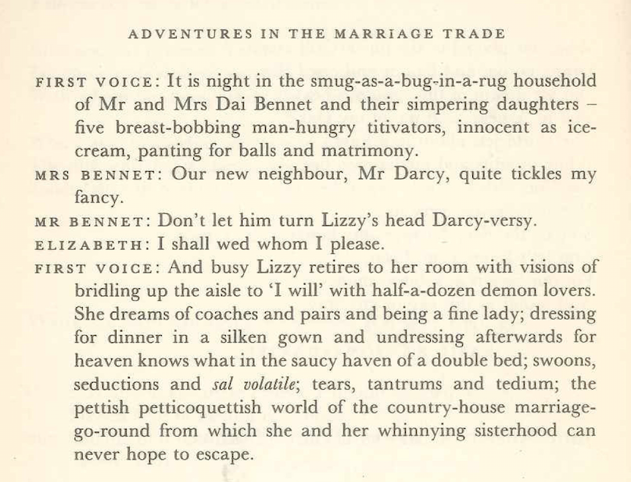

Slide 13
Into the bloodstream:
RESILIENCE

Slide 14
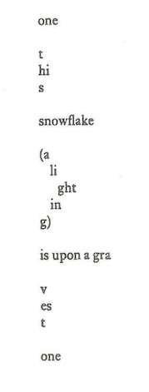

Slide 15
Into the bloodstream:
PLAYFULNESS

Slide 16
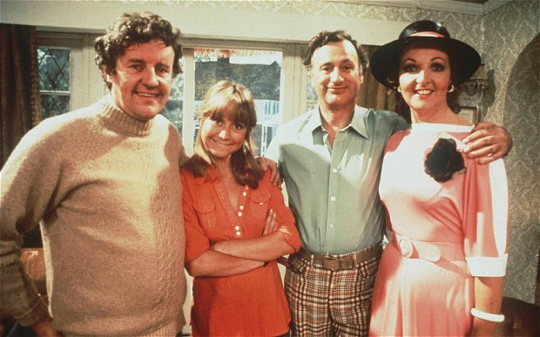

Slide 17
Into the bloodstream:
METALANGUAGE:
Describe what you notice

Slide 18
Into the bloodstream:
SELF-REGULATION:
Describe what you notice

Slide 19
TEST:
1 NECESSARY
2 ACCOMMODATION
3 FEBRUARY
4 HUMOROUS
Notes:
1NECESSARY
2 ACCOMMODATION
3 FEBRUARY
4 HUMOROUS
5 It’s really awful out there; in here, however, it’s quite claustrophobic

Slide 20
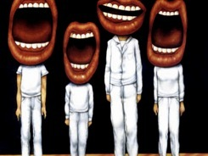
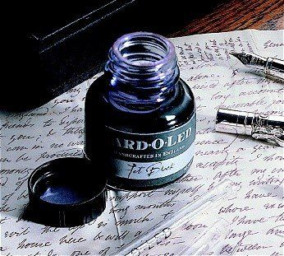

Slide 21
Understand the significance of exploratory talk
Re-think questioning & insist on sentence answers
Vary groupings
Get conversations into the school culture
Model good talk – eg connectives, depersonalisation, passive*

Slide 22
PASSIVE:
For depersonalising discourse (eg scientific, technical and political stuff)
Test: add ‘by zombies’:
‘Potassium was added to the petri dish’
‘It was announced tonight that…’
‘It has been suggested that …’

Slide 23
Know your connectives
Adding: and, also, as well as, moreover, too
Cause & effect: because, so, therefore, thus, consequently
Sequencing: next, then, first, finally, meanwhile, before, after
Qualifying: however, although, unless, except, if, as long as, apart from, yet
Emphasising: above all, in particular, especially, significantly, indeed, notably
Illustrating: for example, such as, for instance, as revealed by, in the case of
Comparing: equally, in the same way, similarly, likewise, as with, like
Contrasting: whereas, instead of, alternatively, otherwise, unlike, on the other hand

Slide 24
READING

Slide 25
Teach reading – scanning, skimming, analysis
Read aloud and display
Teach vocabulary of analysis & tentativeness
Metalanguage:
Formal, colloquial, impersonal, accessible
Teach research, not FOFO

Slide 26
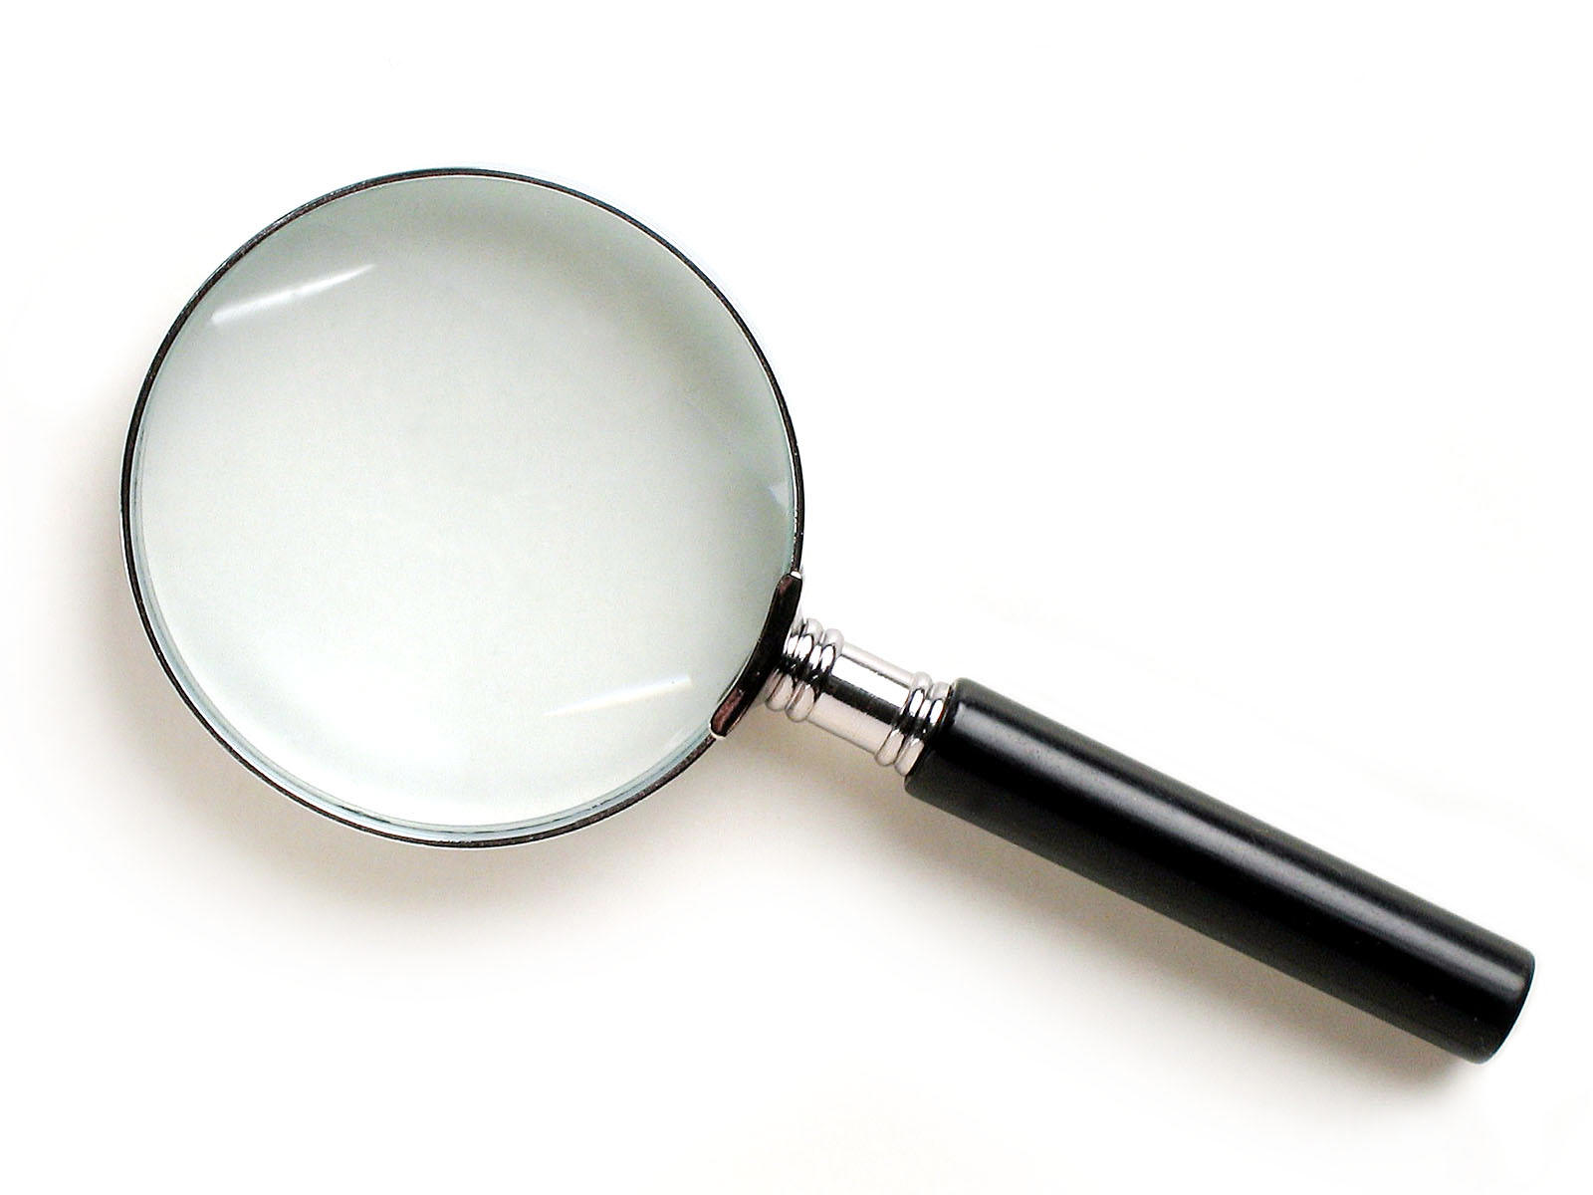
SKIMMING

Slide 27
The climate of the Earth is always changing. In the past it has altered as a result of natural causes. Nowadays, however, the term climate change is generally used when referring to changes in our climate which have been identified since the early part of the 1900s . The changes we've seen over recent years and those which are predicted over the next 80 years are thought to be mainly as a result of human behaviour rather than due to natural changes in the atmosphere.

Slide 28
The best treatment for mouth ulcers. Gargle with salt water. You should find that it works a treat. Salt is cheap and easy to get hold of and we all have it at home, so no need to splash out and spend lots of money on expensive mouth ulcer creams.

Slide 29
Urquhart castle is probably one of the most picturesquely situated castles in the Scottish Highlands. Located 16 miles south-west of Inverness, the castle, one of the largest in Scotland, overlooks much of Loch Ness. Visitors come to stroll through the ruins of the 13th-century castle because Urquhart has earned the reputation of being one of the best spots for sighting Loch Ness’s most famous inhabitant.

Slide 30
Lexical v Grammatical Words

Slide 31
Urquhart castle is probably one of the most picturesquely situated castles in the Scottish Highlands. Located 16 miles south-west of Inverness, the castle, one of the largest in Scotland, overlooks much of Loch Ness. Visitors come to stroll through the ruins of the 13th-century castle because Urquhart has earned the reputation of being one of the best spots for sighting Loch Ness’s most famous inhabitant.

Slide 32
Urquhart castle is probably one of the most picturesquely situated castles in the Scottish Highlands. Located 16 miles south-west of Inverness, the castle, one of the largest in Scotland, overlooks much of Loch Ness. Visitors come to stroll through the ruins of the 13th-century castle because Urquhart has earned the reputation of being one of the best spots for sighting Loch Ness’s most famous inhabitant.

Slide 33
Urquhart castle is probably one of the most picturesquely situated castles in the Scottish Highlands. Located 16 miles south-west of Inverness, the castle, one of the largest in Scotland, overlooks much of Loch Ness. Visitors come to stroll through the ruins of the 13th-century castle because Urquhart has earned the reputation of being one of the best spots for sighting Loch Ness’s most famous inhabitant.

Slide 34
Urquhart castle is probably one of the most picturesquely situated castles in the Scottish Highlands. Located 16 miles south-west of Inverness, the castle, one of the largest in Scotland, overlooks much of Loch Ness. Visitors come to stroll through the ruins of the 13th-century castle because Urquhart has earned the reputation of being one of the best spots for sighting Loch Ness’s most famous inhabitant.

Slide 35
Urquhart castle is probably one of the most picturesquely situated castles in the Scottish Highlands. Located 16 miles south-west of Inverness, the castle, one of the largest in Scotland, overlooks much of Loch Ness. Visitors come to stroll through the ruins of the 13th-century castle because Urquhart has earned the reputation of being one of the best spots for sighting Loch Ness’s most famous inhabitant.

Slide 36
SCANNING

Slide 37
Where did the first cell phones begin?
Name 2 other features that started to be included in phones
Why are cell phones especially useful in some countries?

Slide 38
Where begin?
Two features?
Some countries?
Cellular telephones
The first cellular telephone system began operation in Tokyo in 1979, and the first U.S. system began operation in 1983 in Chicago. A camera phone is a cellular phone that also has picture taking capabilities. Some camera phones have the capability to send these photos to another cellular phone or computer. Advances in digital technology and microelectronics has led to the inclusion of unrelated applications in cellular telephones, such as alarm clocks, calculators, Internet browsers, and voice memos for recording short verbal reminders, while at the same time making such telephones vulnerable to certain software viruses. In many countries with inadequate wire-based telephone networks, cellular telephone systems have provided a means of more quickly establishing a national telecommunications network.

Slide 39
Close Reading

Slide 40
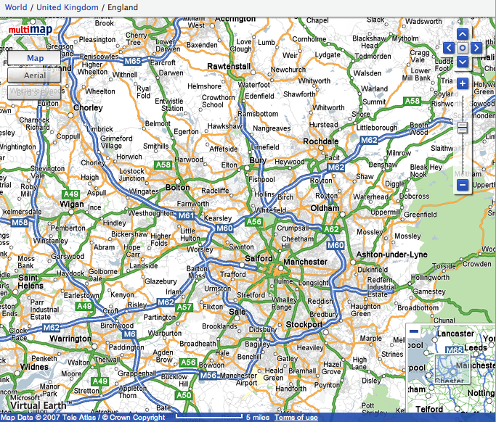

Slide 41
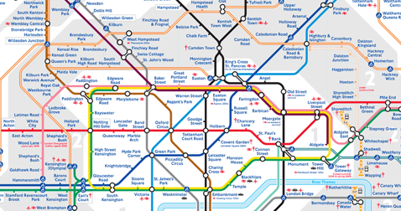
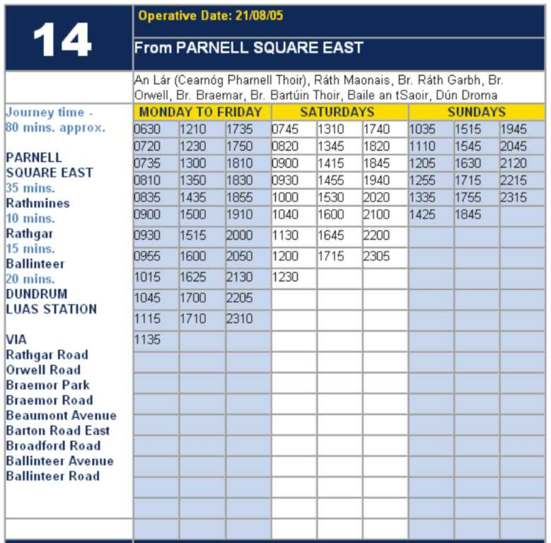
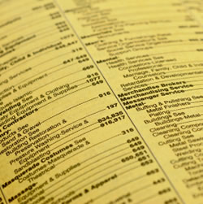

Slide 42
RESEARCH SKILLS

Slide 43
Research the life of
Martin Luther King

Slide 44
So how would you, a fully paid-up member of the literacy club, approach the task?

Slide 45
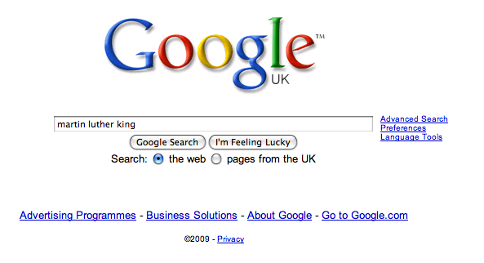

Slide 52
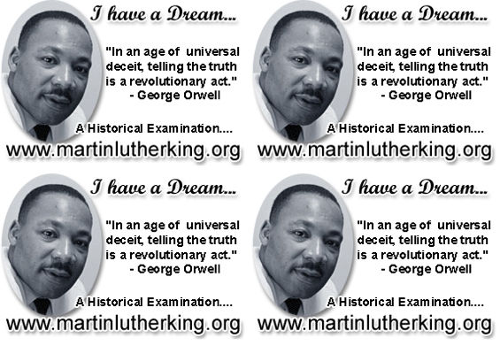

Slide 53
Teach reading – scanning, skimming, analysis
Read aloud and display
Teach vocabulary of analysis & tentativeness
Metalanguage:
Formal, colloquial, impersonal, accessible
Teach research, not FOFO

Slide 54
Demonstrate writing as a process
Write as a reader
Feed it with quality talk and reading
Allow oral rehearsal
Metalanguage:
Textual organisation & voice
Sentence variety & functions
Punctuation for meaning
Connectives
Lexical intolerance

Slide 55
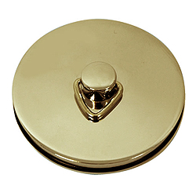
This is an expensive plug ➔

Slide 56
This is a
cheap plug ➔

Slide 57
THE HABITS OF ENGLISH
GEOFF BARTON, HEAD
KING EDWARD VI SCHOOL
@RealGeoffBarton
www.geoffbarton.co.uk (Presentation 135)

