Slide 1
Policy to Practice
Geoff Barton, Headteacher
King Edward VI School, Bury St Edmunds, Suffolk
‘Proud to be a state comprehensive school’
Thursday, 5 June 14
Download this presentation from www.geoffbarton.co.uk/teachers (127)

Slide 2
‘Improving the Leadership of Learning’
Learning
Leadership
Improvement
Notes:
Leadership: responsibility beyond the self

Slide 3
‘Improving the Leadership of Learning’
Political leadership
School Leadership
Subject Leadership

Slide 4
‘Improving the Leadership of Learning’
Is the quality of teaching & learning better now, on my watch?

Slide 5
‘Improving the Leadership of Learning’
Stuff that can be tested
Stuff in the curriculum
LEARNING
Stuff that helps us to navigate our way through life
Stuff that arises from teaching

Slide 6
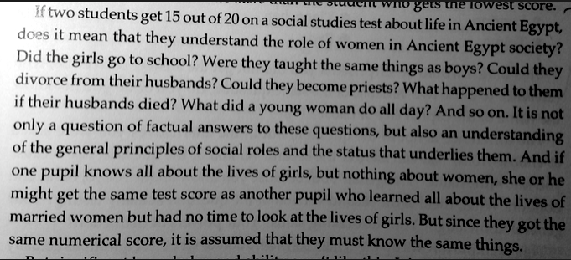
‘Improving the Leadership of Learning’
Graham Nuthall
The Hidden Lives of Learners

Slide 7
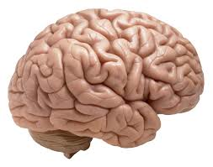
‘Improving the Leadership of Learning’
Has our national understanding of learning narrowed in the past four years?

Slide 8
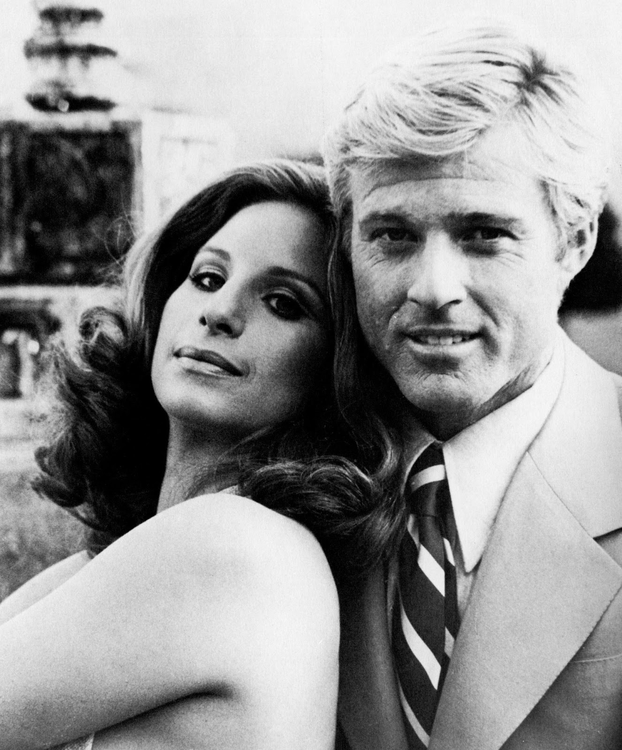

Slide 10
‘Improving the Leadership of Learning’
Annual Conference Sunday 5-7th March 2010

Slide 11
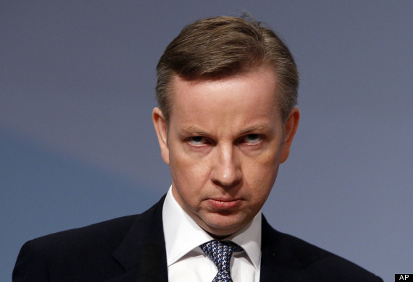
‘Improving the Leadership of Learning’
Michael Gove, Shadow Secretary of State for Children, Schools and Families
Speech to the Association of School and College Leaders
Sunday 7th March 2010

Slide 12
‘Improving the Leadership of Learning’
The best way to help schools that are faltering, or not performing as they should, is to have great teachers, great school leaders, collaborating on driving up standards.
This culture of collaboration, of professional support, of peer review, seems to me to be crucial …

Slide 13
‘Improving the Leadership of Learning’
And for those of you who may have concerns that I am in love with one particular model of school structure and wish to impose it by relentless diktat let me make clear – my desire to see academy freedoms extended springs from precisely the opposite impulse – it’s because I want to see more diversity, more creativity, more professional freedom – that I want to extend autonomy.

Slide 14
‘Improving the Leadership of Learning’
I believe the national curriculum should be a source of collective national pride. It should encompass the best that has been thought and written.

Slide 15
‘Improving the Leadership of Learning’
I have seen that love - whether of history or chemistry, drama or dance - communicated with infectious enthusiasm at meetings of teachers.
And I want to ensure, therefore, that our national curriculum embodies that passion for knowledge, that love of subject, that attachment to learning in each specific field - so we can guarantee an inheritance of excellence.

Slide 16
‘Improving the Leadership of Learning’
I know that the ceaseless pace of change which politicians sometimes insist on can be wearying, but the comprehensive package of reform we’re envisaging is that it’s about allowing you to become freer from political interference, not applying the tourniquet ever more tightly.

Slide 17
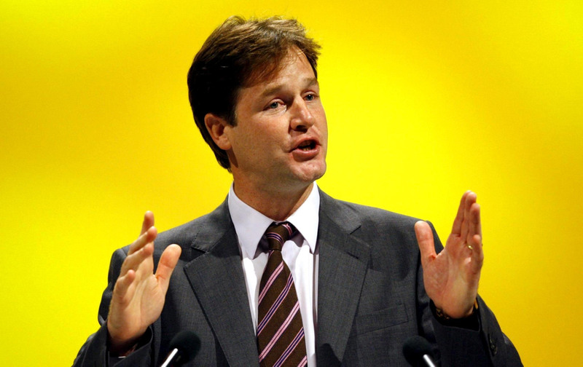
‘Improving the Leadership of Learning’
Nick Clegg, Leader of Liberal Democrats
Saturday 6th March 2010

Slide 18
‘Improving the Leadership of Learning’
In our first parliament we would pass an Education Freedom Act, banning interference from Ministers in the day to day running of schools.
Our ban on political interference would be policed by a new Education Standards Authority. A fully independent guardian of standards, reporting to Parliament, a watchdog that could not be bullied by the Secretary of State.

Slide 19
‘Improving the Leadership of Learning’
David Laws relishes the prospect of scrapping the existing curriculum. He would replace it with a light touch, 25 page ‘Minimum Curriculum Entitlement’ instead.
Any such curriculum would include the option to take more vocational subjects. Many schools feel, like us, the way practical skills are still undervalued is simply wrong.

Slide 20
‘Improving the Leadership of Learning’
I am tired of the buck passing that dominates the debate over education in this country.
When pupils do badly, government blames schools, schools blame government, and parents are left watching endless finger-pointing that does nothing to help their children.

Slide 21
‘Improving the Leadership of Learning’
How do you react?

Slide 22
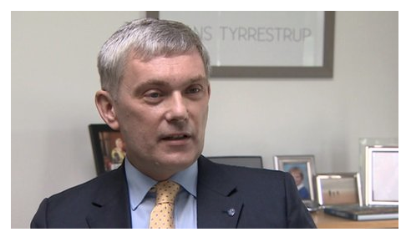
‘Improving the Leadership of Learning’

Slide 23
‘Improving the Leadership of Learning’
The head of one of Norfolk's top state schools has said he regrets his school becoming one of Education Secretary Michael Gove's flagship academies.
Wymondham College principal Melvyn Roffe, accused the Department for Education (DfE) of "micromanaging" schools.
He said he thought the school would gain more freedom but the reality was "more government control".
BBC News, 2 June 2014

Slide 26
‘Improving the Leadership of Learning’
Political leadership
School Leadership
Subject Leadership

Slide 27
‘Improving the Leadership of Learning’
Political leadership

Slide 28
‘Improving the Leadership of Learning’
Implications for the next Secretary of State for Education:
Don’t confuse change with improvement
Learning improves because of what happens in classrooms: professional development is at the core of improving learning
‘What’ gets in the way of ‘how’
‘Freedom’ and ‘autonomy’ aren’t macho; and ‘partnership’ and ‘collaboration’ aren’t sissy
The comprehensive ideal is a noble one

Slide 29
‘Improving the Leadership of Learning’
Political leadership
School Leadership

Slide 30
‘Improving the Leadership of Learning’
Specialist status
National College
Leading Edge
NPQH
Beacon Schools
Workforce remodelling
National strategies
Advanced skills teachers
Atriums

Slide 31
‘Improving the Leadership of Learning’
☑ ☒
Shared mission vindicated by results
We weren’t intolerant enough of mediocrity

Slide 32
‘Improving the Leadership of Learning’
Implications for school leaders:
Values aren’t just an NPQH session
The quality of learning isn’t just about the quality of teaching: ethos matters
It’s all about teaching and learning – and school leaders have to be able to do it, visibly
Choice & competition may be delusions
We have to be able to look ourselves in the eye: ‘let’s say “no” more’ and take more risks

Slide 33
‘Improving the Leadership of Learning’
Political leadership
School Leadership
Subject Leadership

Slide 34
‘Improving the Leadership of Learning’
Implications for subject leaders:
Be able to answer the question: ‘What is [subject] for in my school, beyond the prescribed curriculum’?
What are the micro-skills that signal great teaching and are they being taught, modelled, coached?
Are we using national standards to increase accountability?
Are we incentivising ‘getting better’ as teachers and being intolerant where it’s not good enough?
Is the real joy of being a teacher palpable in meetings, departmental offices, lunchtime discussions?

Slide 35
‘Improving the Leadership of Learning’
Political leadership
School Leadership
Subject Leadership

Slide 36
‘Improving the Leadership of Learning’
Is the quality of teaching & learning better now, on my watch?

Slide 37
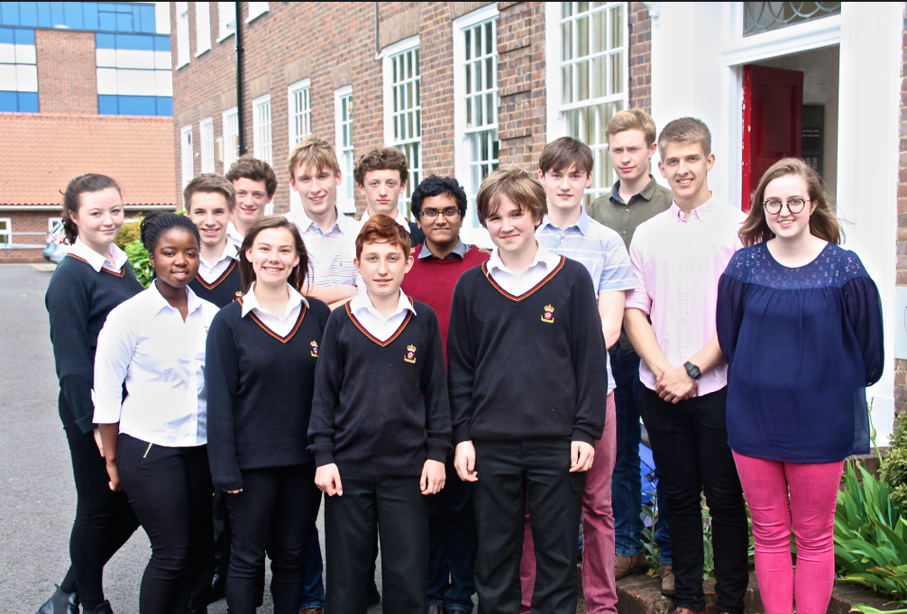
‘Improving the Leadership of Learning’

Slide 38
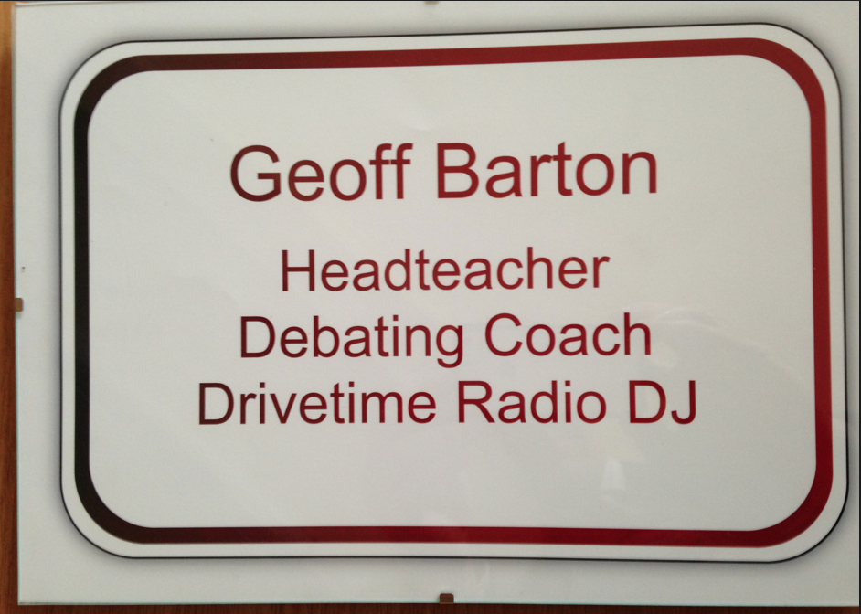
‘Improving the Leadership of Learning’

Slide 39
Policy to Practice
Geoff Barton, Headteacher
King Edward VI School, Bury St Edmunds, Suffolk
‘Proud to be a state comprehensive school’
Thursday, 5 June 14
Download this presentation from www.geoffbarton.co.uk/teachers (127)

