Slide 1
Don’t Call it Literacy!
Geoff Barton, Head,
King Edward VI School, Suffolk
November 14, 2013
Twitter: @RealGeoffBarton
Download this presentation free at:
www.geoffbarton.co.uk
(Teacher Resources: 124)

Slide 2
Don’t Call it Literacy!
Geoff Barton, Head,
King Edward VI School, Suffolk
November 15, 2013
Twitter: @RealGeoffBarton
Download this presentation free at:
www.geoffbarton.co.uk
(Teacher Resources: 124)

Slide 3
Shouldn’t we be angrier?

Slide 4
Young people
Notes:
Little over 60% get 5A*-C at 16, 11 years of compulsory education – and that it’s worn as a badge of national honour – that the enthusiasm for reading they show at 10 is crushed by 16

Slide 5
Parents
Notes:
Homes without books – atomised lifestyles – conversation with 6 year old -

Slide 6
Teachers
Notes:
Phoney writing – silent reading – that we leave it to the lottery

Slide 7
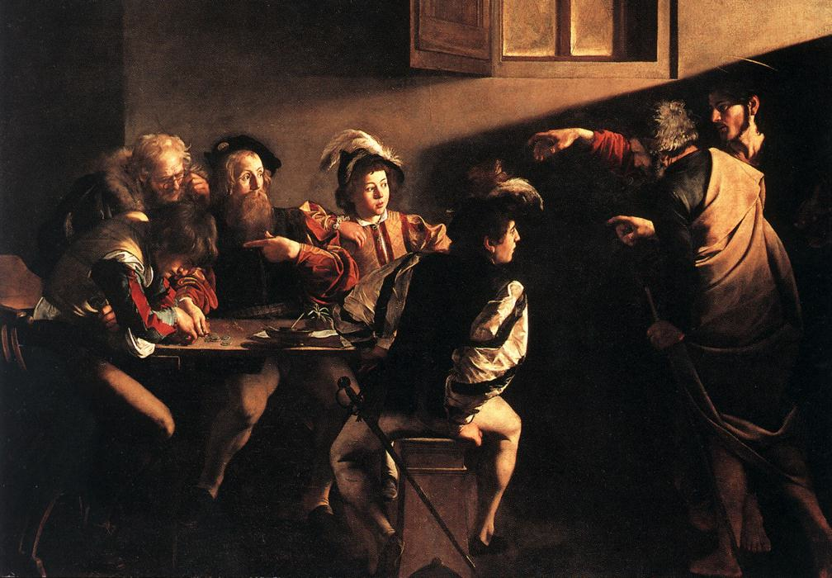
The word-rich get richer while the word-poor get poorer
Canadian Association of School Librarians

Slide 8
We are the word-rich
Notes:
Words of power / tentativeness / reading matters /

Slide 9
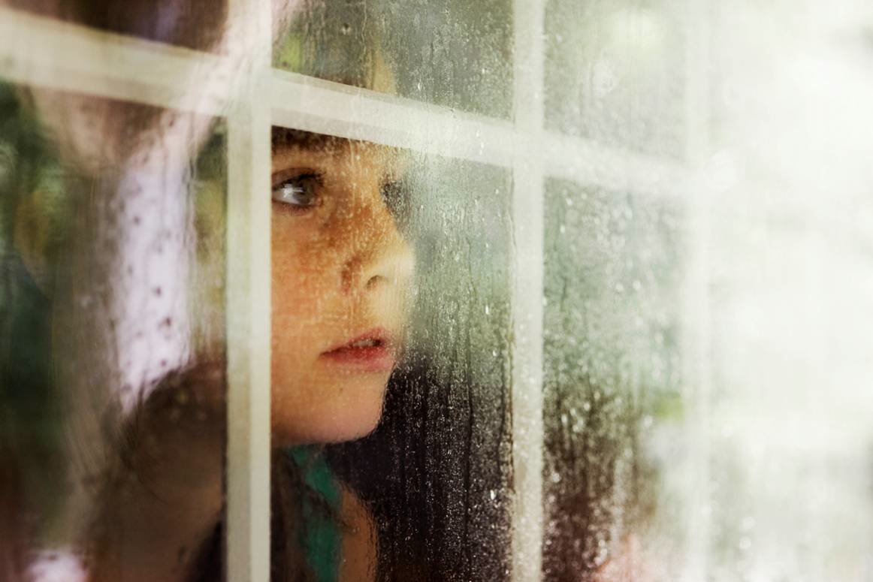

Slide 10
‘Too often the argument for reading is made by those who have spent their lives as insiders; the pleasures of solitary reading are so obvious, the value of reading so self-evident, that we fail to appreciate how utterly strange reading is to the outsider’
Thomas Newkirk,
‘Misreading Masculinity:
Boys, Literacy and Popular Culture’

Slide 11
‘Students who begin with high verbal aptitudes find themselves in verbally enriched social environments and have a double advantage’
‘The Matthew Effect’
Daniel Rigney

Slide 12
‘While good readers gain new skills very rapidly, and quickly move from learning to read to reading to learn, poor readers become increasingly frustrated with the act of reading, and try to avoid reading where possible’
‘The Matthew Effect’
Daniel Rigney

Slide 13
‘Spoken language forms a constraint, a ceiling not only on the ability to comprehend, but also on the ability to write, beyond which literacy cannot progress’
Myhill and Fisher
‘Informing practice in English’

Slide 14
Notes:
Here just for Ofsted – shame on you

Slide 15
Key terms and vocabulary
Spelling
Core skills (skimming, scanning)
Conventions
Accuracy
Standard English
Spelling, grammar or punctuation
Marking to support literacy.
Notes:
Here just for Ofsted – shame on you

Slide 16
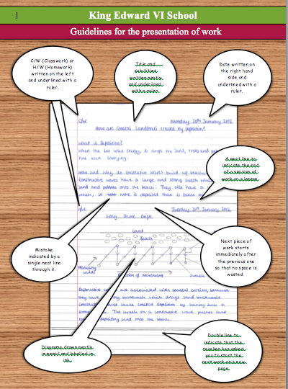
Notes:
Here just for Ofsted – shame on you

Slide 17
Notes:
Here just for Ofsted – shame on you

Slide 18
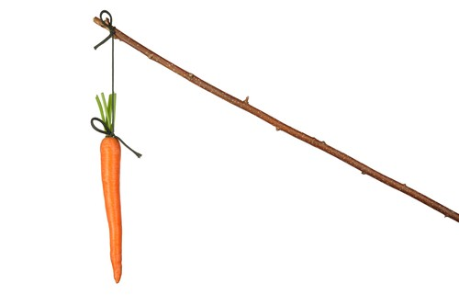
Notes:
Words of power / tentativeness / reading matters /

Slide 19
Ofsted
Notes:
Words of power / tentativeness / reading matters /

Slide 20
Teachers’ Standards
Notes:
Words of power / tentativeness / reading matters /

Slide 21
3. DEMONSTRATE GOOD SUBJECT AND CURRICULUM KNOWLEDGE
3(c) demonstrate an understanding of and take responsibility for promoting high standards of literacy, articulacy and the correct use of standard English, whatever the teacher’s specialist subject
Notes:
Words of power / tentativeness / reading matters /

Slide 22
Appraisal
Notes:
Marking

Slide 23
We are the word-rich and there are things we do
Notes:
It’s really beautiful out there, although winter is beginning to flex its muscles.

Slide 24
Demo: 1 sentence
Notes:
It’s really beautiful out there, although winter is beginning to flex its muscles.

Slide 25
We are the word-rich and there are things we do
Notes:
It’s really beautiful out there, although winter is beginning to flex its muscles.

Slide 26
1: We self-regulate: we know that accuracy counts (in many contexts)

Slide 27
2: We understand ‘interestingness’: sentence & lexical variety

Slide 28
3: We know that reading matters: we have reading strategies

Slide 29
4: We know that some words in our culture carry extraordinary power
Notes:
Analytical words – suggests; connectives – however; modal verbs - would

Slide 30
5: We keep these things secret

Slide 31
What if we made the implicit explicit …
… by teaching it

Slide 32
SKIMMING

Slide 33
The climate of the Earth is always changing. In the past it has altered as a result of natural causes. Nowadays, however, the term climate change is generally used when referring to changes in our climate which have been identified since the early part of the 1900's . The changes we've seen over recent years and those which are predicted over the next 80 years are thought to be mainly as a result of human behaviour rather than due to natural changes in the atmosphere.

Slide 35
The climate of the Earth is always changing. In the past it has altered as a result of natural causes. Nowadays, however, the term climate change is generally used when referring to changes in our climate which have been identified since the early part of the 1900's . The changes we've seen over recent years and those which are predicted over the next 80 years are thought to be mainly as a result of human behaviour rather than due to natural changes in the atmosphere.

Slide 36
Plaque is a yellow sticky film that forms on the teeth and gums and can be seen at gum margins of teeth with a food dye. The bacteria in plaque convert carbohydrates in food (such as sugar) into acid that demineralises teeth, eventually causing cavities. Daily brushing and flossing removes plaque and can prevent tartar from forming on the teeth.
Plaque can also cause gum irritation (gingivitis), making them red, tender and cause them to bleed. In some cases, the gums pull away from the teeth (receding gums), leaving cavities inhabited by bacteria and pus. If this is not treated, bones around the teeth can be destroyed.^{[citation needed]}

Slide 38
Plaque is a yellow sticky film that forms on the teeth and gums and can be seen at gum margins of teeth with a food dye. The bacteria in plaque convert carbohydrates in food (such as sugar) into acid that demineralises teeth, eventually causing cavities. Daily brushing and flossing removes plaque and can prevent tartar from forming on the teeth.
Plaque can also cause gum irritation (gingivitis), making them red, tender and cause them to bleed. In some cases, the gums pull away from the teeth (receding gums), leaving cavities inhabited by bacteria and pus. If this is not treated, bones around the teeth can be destroyed.^{[citation needed]}

Slide 39
Lexical v Grammatical Words

Slide 40
Urquhart castle is probably one of the most picturesquely situated castles in the Scottish Highlands. Located 16 miles south-west of Inverness, the castle, one of the largest in Scotland, overlooks much of Loch Ness. Visitors come to stroll through the ruins of the 13th-century castle because Urquhart has earned the reputation of being one of the best spots for sighting Loch Ness’s most famous inhabitant.

Slide 41
Urquhart castle is probably one of the most picturesquely situated castles in the Scottish Highlands. Located 16 miles south-west of Inverness, the castle, one of the largest in Scotland, overlooks much of Loch Ness. Visitors come to stroll through the ruins of the 13th-century castle because Urquhart has earned the reputation of being one of the best spots for sighting Loch Ness’s most famous inhabitant.

Slide 42
Urquhart castle is probably one of the most picturesquely situated castles in the Scottish Highlands. Located 16 miles south-west of Inverness, the castle, one of the largest in Scotland, overlooks much of Loch Ness. Visitors come to stroll through the ruins of the 13th-century castle because Urquhart has earned the reputation of being one of the best spots for sighting Loch Ness’s most famous inhabitant.

Slide 43
Urquhart castle is probably one of the most picturesquely situated castles in the Scottish Highlands. Located 16 miles south-west of Inverness, the castle, one of the largest in Scotland, overlooks much of Loch Ness. Visitors come to stroll through the ruins of the 13th-century castle because Urquhart has earned the reputation of being one of the best spots for sighting Loch Ness’s most famous inhabitant.

Slide 44
Urquhart castle is probably one of the most picturesquely situated castles in the Scottish Highlands. Located 16 miles south-west of Inverness, the castle, one of the largest in Scotland, overlooks much of Loch Ness. Visitors come to stroll through the ruins of the 13th-century castle because Urquhart has earned the reputation of being one of the best spots for sighting Loch Ness’s most famous inhabitant.

Slide 45
SCANNING

Slide 46
Where did the first cell phones begin?
Name 2 other features that started to be included in phones
Why are cell phones especially useful in some countries?

Slide 47
Where begin?
Two features?
Some countries?
Cellular telephones
The first cellular telephone system began operation in Tokyo in 1979, and the first U.S. system began operation in 1983 in Chicago. A camera phone is a cellular phone that also has picture taking capabilities. Some camera phones have the capability to send these photos to another cellular phone or computer. Advances in digital technology and microelectronics has led to the inclusion of unrelated applications in cellular telephones, such as alarm clocks, calculators, Internet browsers, and voice memos for recording short verbal reminders, while at the same time making such telephones vulnerable to certain software viruses. In many countries with inadequate wire-based telephone networks, cellular telephone systems have provided a means of more quickly establishing a national telecommunications network.

Slide 48
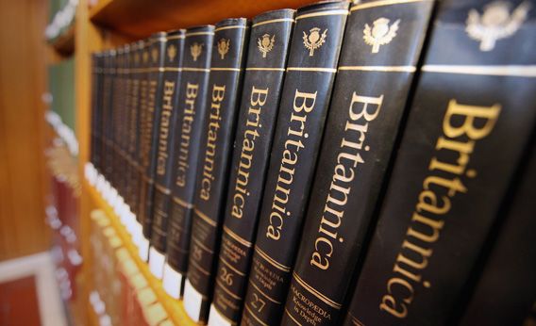
RESEARCH SKILLS

Slide 49
Research the life of
Martin Luther King

Slide 50
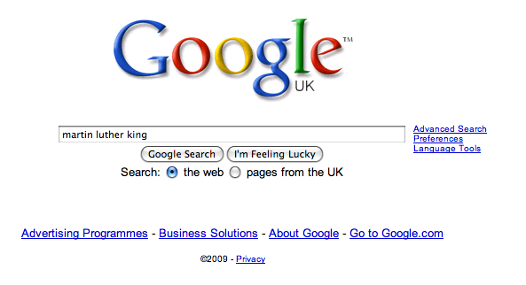

Slide 58
Writing

Slide 59
A: Write a horror story

Slide 60
B: Write a horror story located in a benign setting

Slide 61
C: Write a horror story located in a benign setting using narrative disjuncture and second-person voice

Slide 62
The word-rich get richer while the word-poor get poorer
Canadian Association of School Librarians

Slide 63
Don’t Call it Literacy!
Geoff Barton, Head,
King Edward VI School, Suffolk
November 15, 2013
Twitter: @RealGeoffBarton
Download this presentation free at:
www.geoffbarton.co.uk
(Teacher Resources: 124)

Slide 64
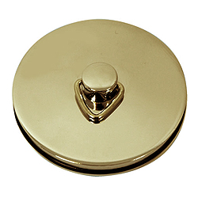
This is an expensive plug ➔

Slide 65
This is a
cheap plug ➔

Slide 66
Don’t Call it Literacy!
Geoff Barton, Head,
King Edward VI School, Suffolk
November 15, 2013
Twitter: @RealGeoffBarton
Download this presentation free at:
www.geoffbarton.co.uk
(Teacher Resources: 124)

