Slide 1

Outstanding Leadership of Literacy
Geoff Barton
Head, King Edward VI School
Suffolk
Teachology
2 March 2017
Twitter: @RealGeoffBarton
Presentation free at: geoffbarton.co.uk/teacher-resources (number 146)

Slide 2
What are you hoping to get out of today?
Notes:
1 accommodation; 2 necessary; 3 separate; 4 fulfil; 5 they’re

Slide 3
Plan
Notes:
1 accommodation; 2 necessary; 3 separate; 4 fulfil; 5 they’re

Slide 4
SHAPE OF THE DAY
10 to 11:30 am:
Reaffirming the case for whole-school literacy
11:30 to 11:45
Break
11:45 to 13:15:
Literacy in practice
Focus on speaking & listening
Focus on reading
Focus on writing
13:15 to 14:00
Lunch
14:00 to 15:15
Making it happen

Slide 5
Compare and contrast:
A
The Global Positioning System (GPS) is a network of about 30 satellites orbiting the Earth at an altitude of 20,000 km. The system was originally developed by the US government for military navigation but now anyone with a GPS device, be it a SatNav, mobile phone or handheld GPS unit, can receive the radio signals that the satellites broadcast.
Wherever you are on the planet, at least four GPS satellites are ‘visible’ at any time. Each one transmits information about its position and the current time at regular intervals. These signals, travelling at the speed of light, are intercepted by your GPS receiver, which calculates how far away each satellite is based on how long it took for the messages to arrive.
B
GPS (global positioning system) can be defined as a collection of satellites and ground stations that allow users with specifically designed radio equipment to obtain position, distance and velocity data. Mariners at one time used constellations and the stars (such as Polaris in the Little Dipper or Alpha Ursae Minoris) as landmarks at night to determine their position and direction at sea. The distance from a satellite is calculated by the “time of flight” of a radio signal from the satellite. Suppose it takes 0.06 seconds for a radio signal traveling at 186000 miles per second to reach the receiver from the satellite. Knowing this, the distance from the satellite can be calculated as follows:
Velocity (186000 mi/s) x Time (.06 s) = Distance (11160 miles)
Notes:
http://www.physics.org/article-questions.asp?id=55

Slide 6
The HABITS of Literacy

Slide 7
Arthur L. Costa and Bena Kallick, Habits of Mind

Slide 8
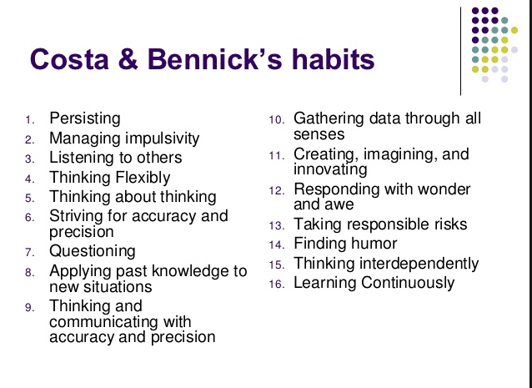

Slide 9
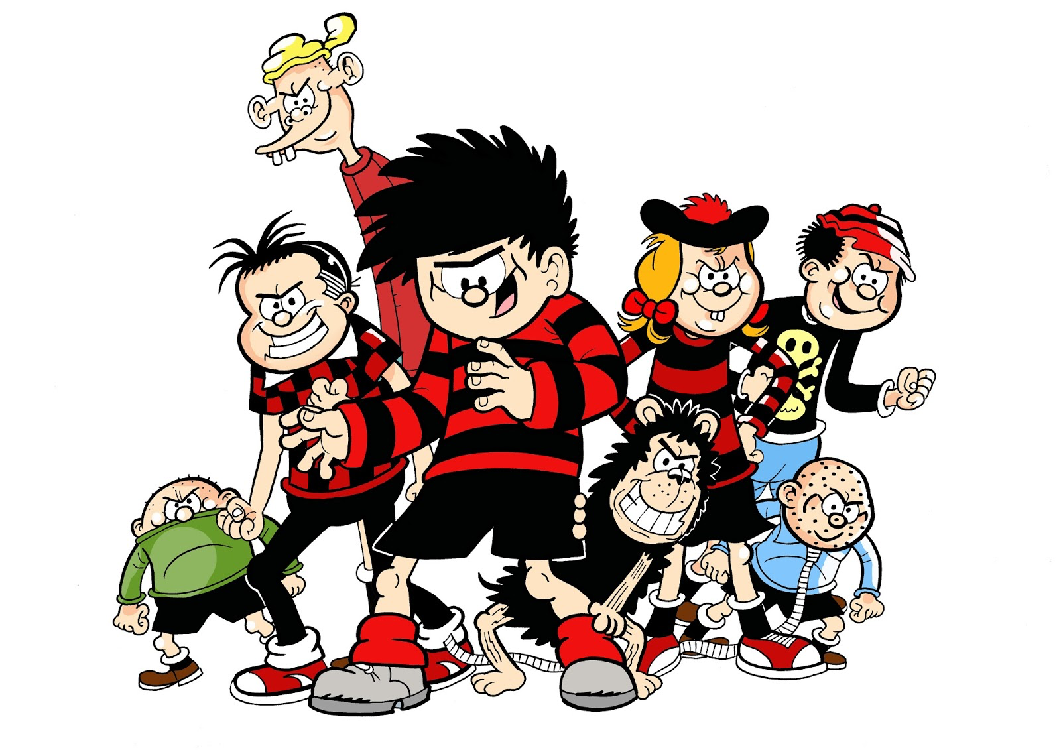
The view from the lunch queue

Slide 10
3

Slide 11
Teaching
Learning
Leadership

Slide 12

2

Slide 13

1:

Slide 14
2:
Literacy

Slide 15
WHY
WHAT
HOW

Slide 16
Challenges

Slide 17
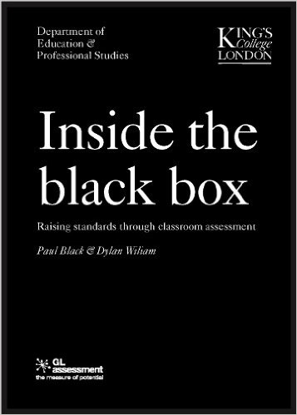
‘Standards are raised ONLY by changes which are put into direct effect by teachers and pupils in classrooms’

Slide 18
'A bad curriculum well taught is invariably a better experience than a good curriculum badly taught' (2011) Dylan William

Slide 19
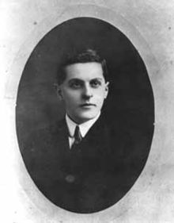
“The limits of my language mean the limits of my world”
Ludwig Wittgenstein

Slide 20

10 Texts

Slide 21
Literacy

Slide 22

“The children who possess intellectual capital when they first arrive at school have the mental scaffolding and Velcro to catch hold of what is going on, and they can turn the new knowledge into still more Velcro to gain still more knowledge”.

Slide 23
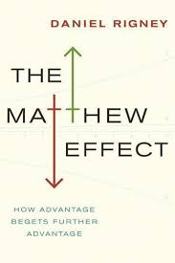
Whilst the word rich get richer, the word poor get poorer

Slide 24
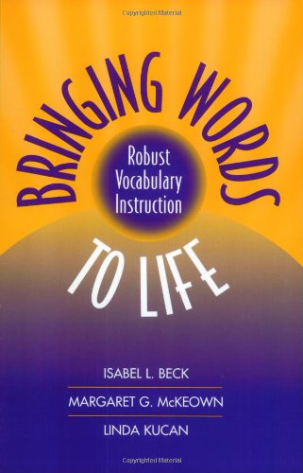
People who have large vocabularies tend to be intrigued with words.
As such, a major impetus for writing this book is our concern that school vocabulary instruction tends to be dull, rather than of the sort that might instigate students’ interest and awareness of words.
Indeed, asking students to look up words in a dictionary and use them in a sentence is a stereotypical example of what students find uninteresting in school.

Slide 25

‘Too often the argument for reading is made by those who have spent their lives as insiders. The pleasures of solitary reading are so obvious, the value of reading so self-evident, that we fail to appreciate how utterly strange reading is to the outsider’

Slide 26
Pedagogy

Slide 27

In my experience, teaching is about sensitivity and adaptation. Things that work one day may not work the next day.
In order to navigate the complexity of the circumstances in which a teacher works, it is not possible just to follow a recipe. As a teacher, you make adaptations. You must.

Slide 28
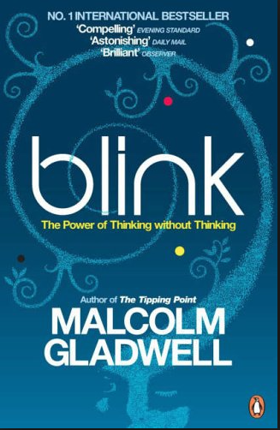
Participants viewed 6-second silent video clips before evaluating the teachers.
95% correlation

Slide 29
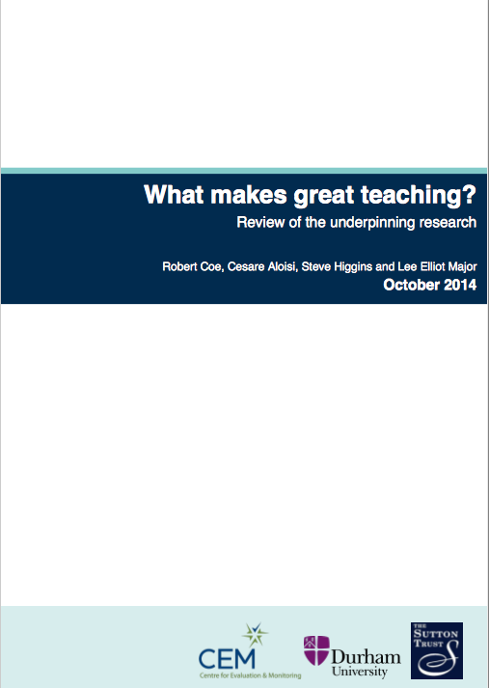
Content knowledge (Strong evidence of impact on student outcomes)
Quality of instruction (Strong evidence of impact on student outcomes)
Classroom climate (Moderate evidence of impact on student outcomes)
Classroom management (Moderate evidence of impact on student outcomes)

Slide 30
Leadership

Slide 31
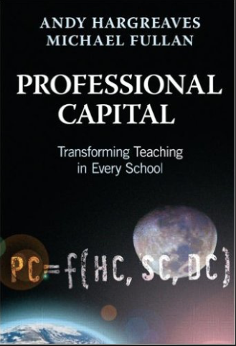
Three-quarters of teachers who demonstrated sustained commitment said that good leadership helped them sustain their commitment over time.
Better leaders produce better teachers.

Slide 32
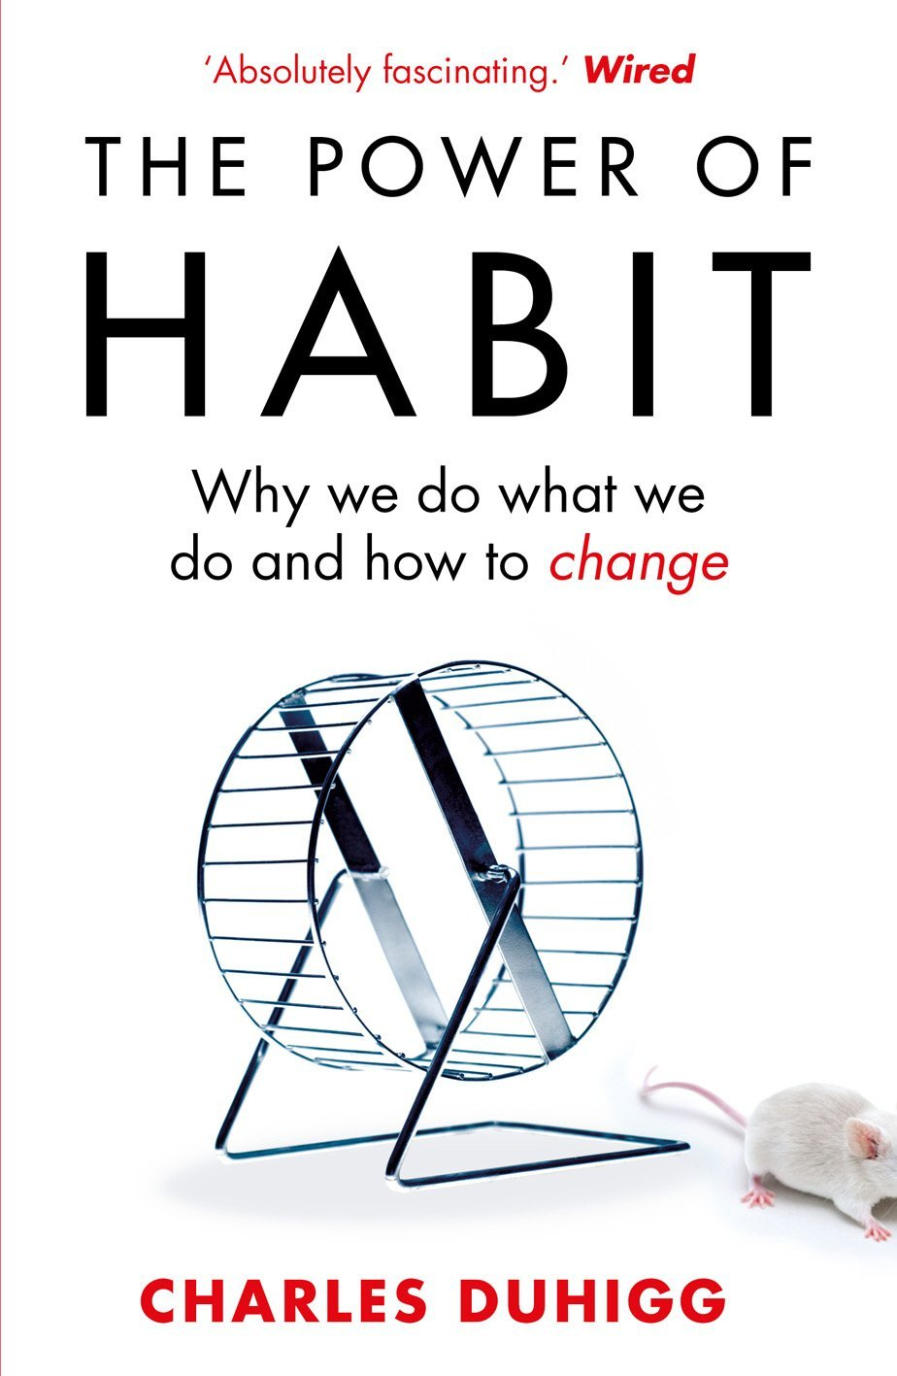
‘Habits, scientists say, emerge because the brain is constantly looking for ways to save effort’

Slide 33
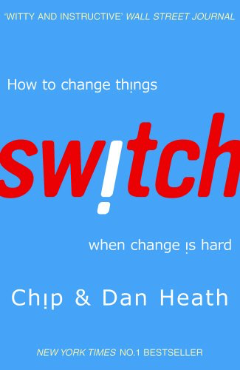
All change is making people behave differently
What looks like resistance can be lack of clarity
Importance of “bright spots” - showcasing positive examples
Big problems are often solved with a sequence of small solutions
Intrinsic motivation: make first grades aspire to be third graders

Slide 34

What
How
Why

Slide 35
What are you thinking?
What have you learnt so far?
Implications for you and your role?

Slide 36
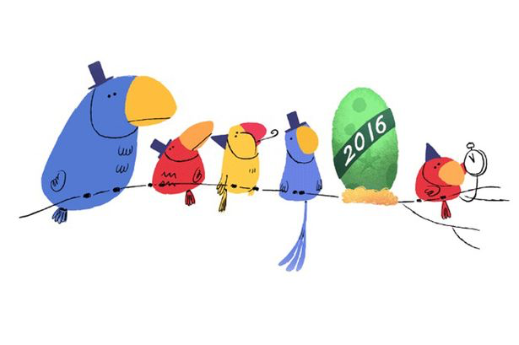
The Changing Face of Literacy

Slide 37
How do you react to these rooms?

Slide 38
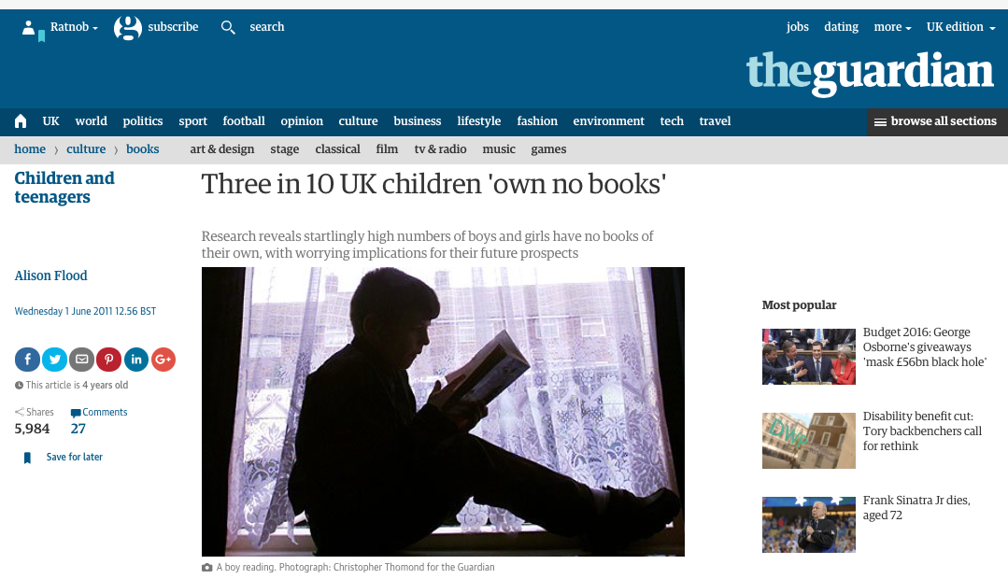

Slide 39
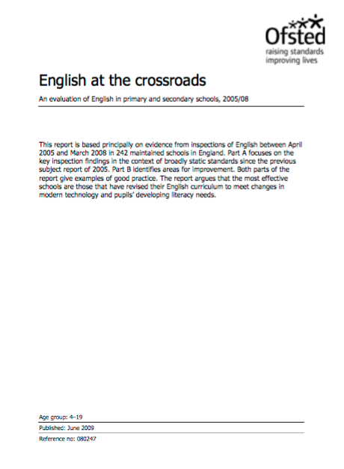

Slide 40
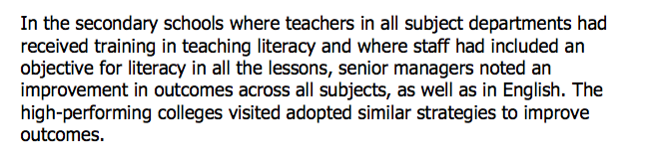

Slide 41
FUTURE

Slide 42
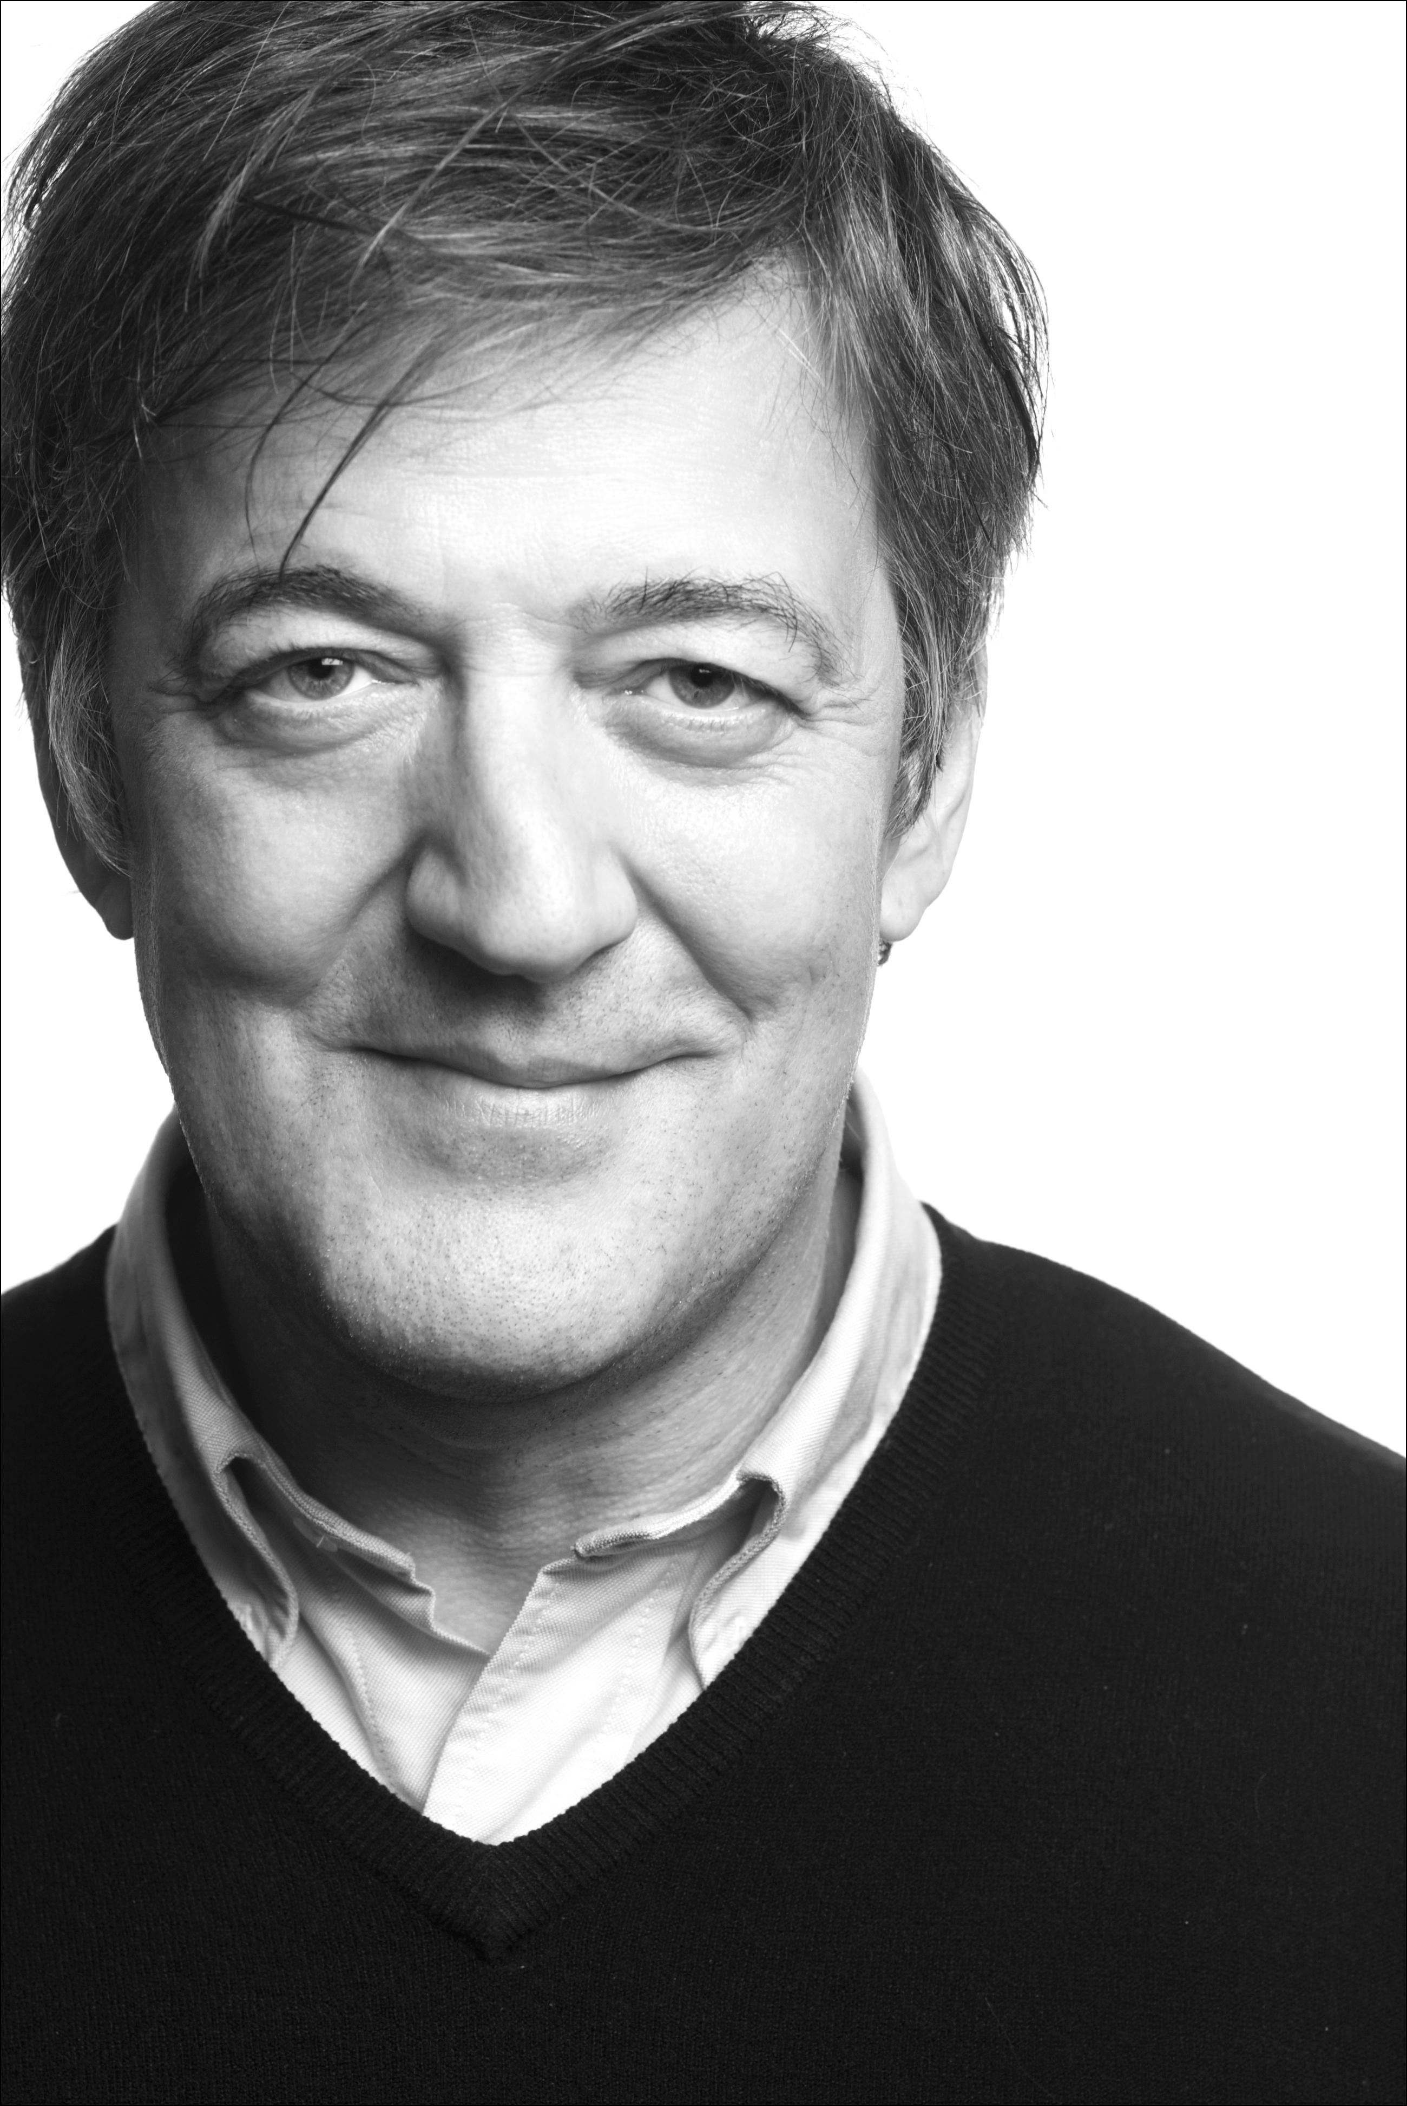
Books are no more threatened by Kindle than stairs by elevators.
STEPHEN FRY

Slide 43
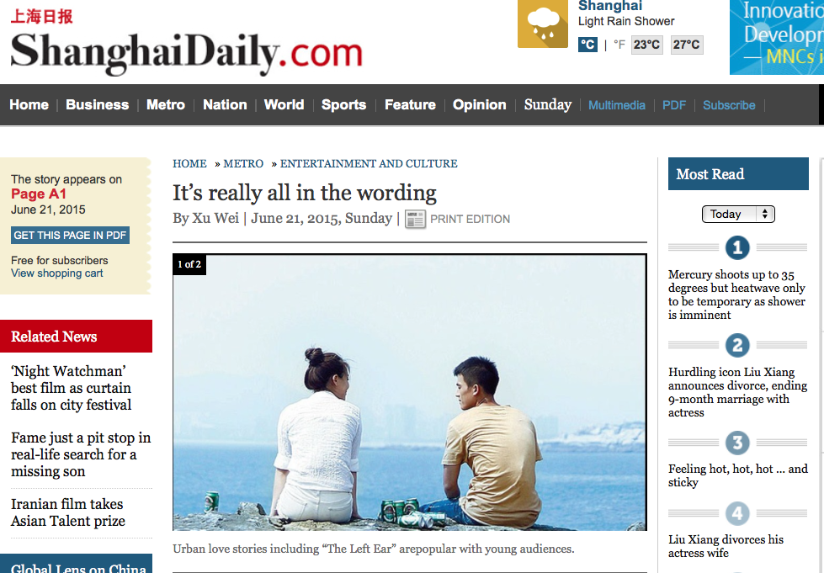

Slide 44
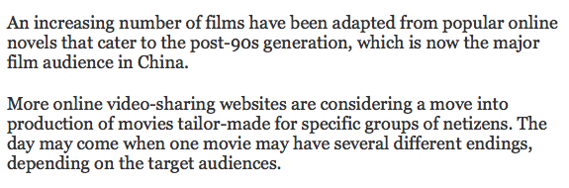

Slide 45
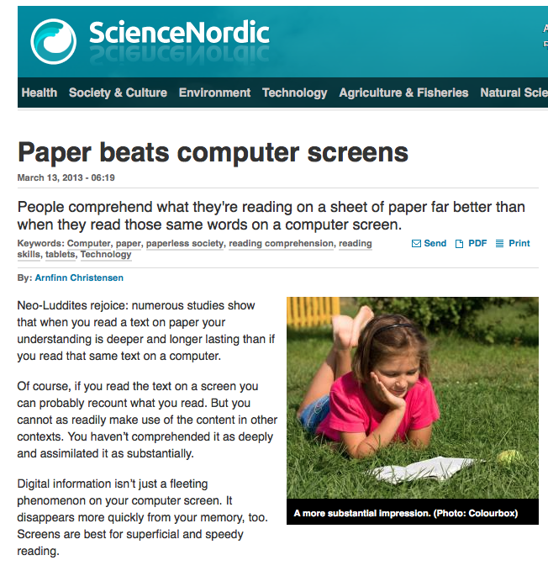

Slide 46
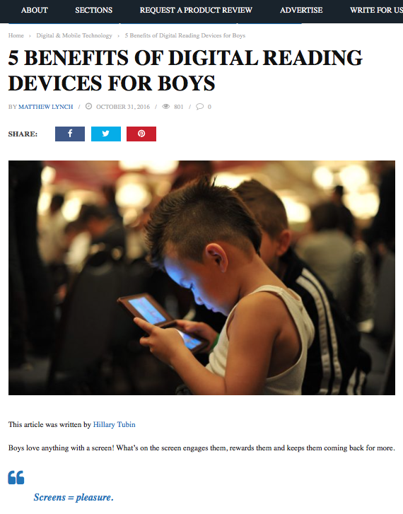

Slide 47

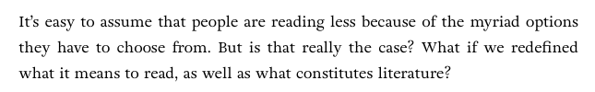

Slide 48
PAST

Slide 49
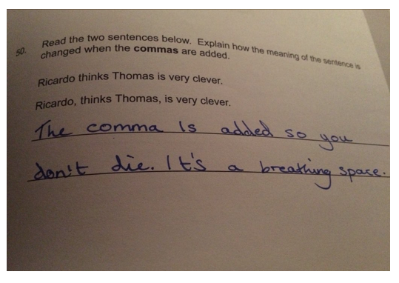
Notes:
Driven by testing - 1

Slide 50
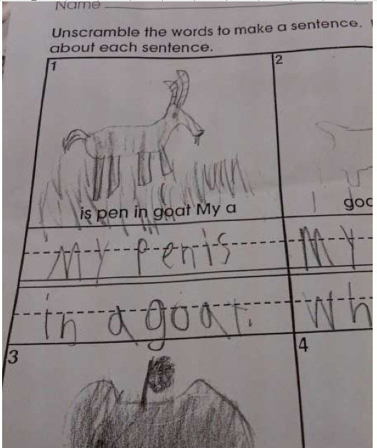
Notes:
Driven by testing - 1

Slide 51
What are you thinking?
What have you learnt so far?
Implications for you and your role?

Slide 52
WHAT

Slide 53

Understand the significance of exploratory talk
Build extended responses & public speaking
Model good talk – eg connectives
Consciously vary groupings
Re-think questioning – ‘why & how’, thinking time, and kill fatuous praise

Slide 54
What are you thinking?
What have you learnt so far?
Implications for you and your role?

Slide 55
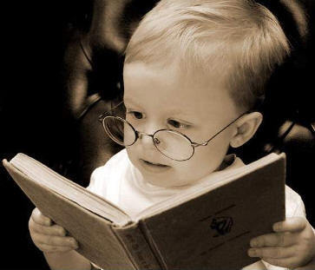
Teach and model reading
Personalise reading
Teach key vocabulary
Demystify spelling
Teach research, not FOFO

Slide 56

SKIMMING

Slide 57
The climate of the Earth is always changing. In the past it has altered as a result of natural causes. Nowadays, however, the term climate change is generally used when referring to changes in our climate which have been identified since the early part of the 1900's . The changes we've seen over recent years and those which are predicted over the next 80 years are thought to be mainly as a result of human behaviour rather than due to natural changes in the atmosphere.

Slide 58
The best treatment for mouth ulcers. Gargle with salt water. You should find that it works a treat. Salt is cheap and easy to get hold of and we all have it at home, so no need to splash out and spend lots of money on expensive mouth ulcer creams.

Slide 59
Lexical v Grammatical Words

Slide 60
Urquhart castle is probably one of the most picturesquely situated castles in the Scottish Highlands. Located 16 miles south-west of Inverness, the castle, one of the largest in Scotland, overlooks much of Loch Ness. Visitors come to stroll through the ruins of the 13th-century castle because Urquhart has earned the reputation of being one of the best spots for sighting Loch Ness’s most famous inhabitant.

Slide 61
Urquhart castle is probably one of the most picturesquely situated castles in the Scottish Highlands. Located 16 miles south-west of Inverness, the castle, one of the largest in Scotland, overlooks much of Loch Ness. Visitors come to stroll through the ruins of the 13th-century castle because Urquhart has earned the reputation of being one of the best spots for sighting Loch Ness’s most famous inhabitant.

Slide 62
Urquhart castle is probably one of the most picturesquely situated castles in the Scottish Highlands. Located 16 miles south-west of Inverness, the castle, one of the largest in Scotland, overlooks much of Loch Ness. Visitors come to stroll through the ruins of the 13th-century castle because Urquhart has earned the reputation of being one of the best spots for sighting Loch Ness’s most famous inhabitant.

Slide 63
Urquhart castle is probably one of the most picturesquely situated castles in the Scottish Highlands. Located 16 miles south-west of Inverness, the castle, one of the largest in Scotland, overlooks much of Loch Ness. Visitors come to stroll through the ruins of the 13th-century castle because Urquhart has earned the reputation of being one of the best spots for sighting Loch Ness’s most famous inhabitant.

Slide 64
Urquhart castle is probably one of the most picturesquely situated castles in the Scottish Highlands. Located 16 miles south-west of Inverness, the castle, one of the largest in Scotland, overlooks much of Loch Ness. Visitors come to stroll through the ruins of the 13th-century castle because Urquhart has earned the reputation of being one of the best spots for sighting Loch Ness’s most famous inhabitant.

Slide 65

SCANNING

Slide 66
Where did the first cell phones begin?
Name 2 other features that started to be included in phones
Why are cell phones especially useful in some countries?

Slide 67
Where begin?
Two features?
Some countries?
Cellular telephones
The first cellular telephone system began operation in Tokyo in 1979, and the first U.S. system began operation in 1983 in Chicago. A camera phone is a cellular phone that also has picture taking capabilities. Some camera phones have the capability to send these photos to another cellular phone or computer. Advances in digital technology and microelectronics has led to the inclusion of unrelated applications in cellular telephones, such as alarm clocks, calculators, Internet browsers, and voice memos for recording short verbal reminders, while at the same time making such telephones vulnerable to certain software viruses. In many countries with inadequate wire-based telephone networks, cellular telephone systems have provided a means of more quickly establishing a national telecommunications network.

Slide 68
CLOSE READING

Slide 69
An underpinning approach to reading

Slide 70
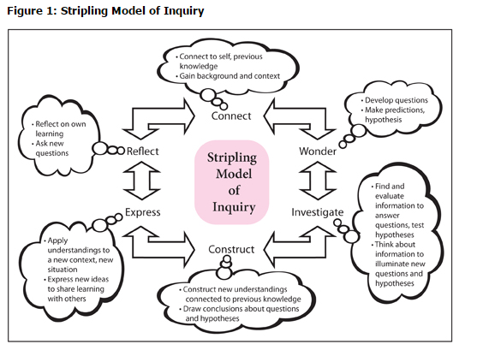

RESEARCH SKILLS

Slide 71
RESEARCH SKILLS

Slide 72
Research the life of
Martin Luther King

Slide 73
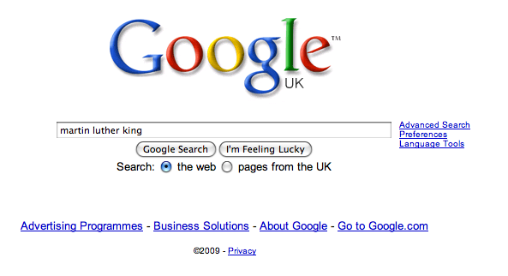

Slide 74


Slide 75
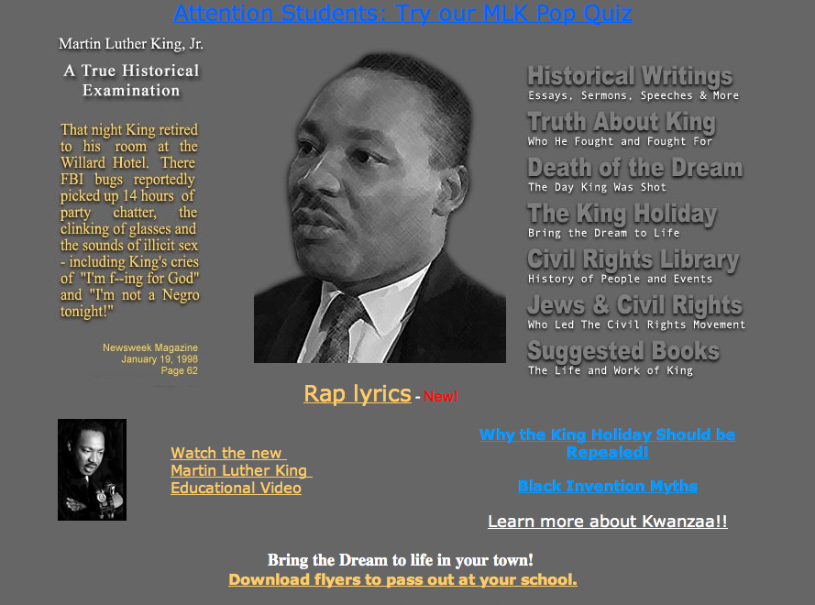


Slide 76
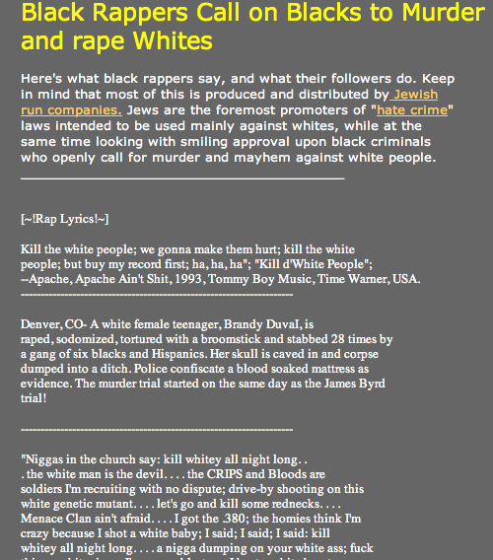

Slide 77
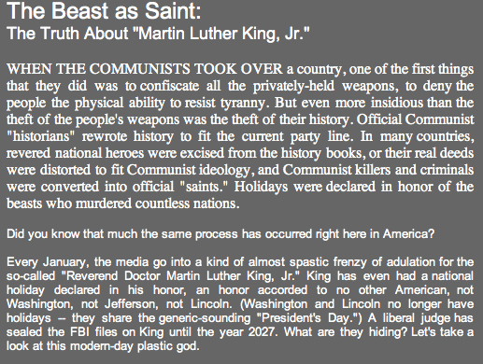

Slide 78
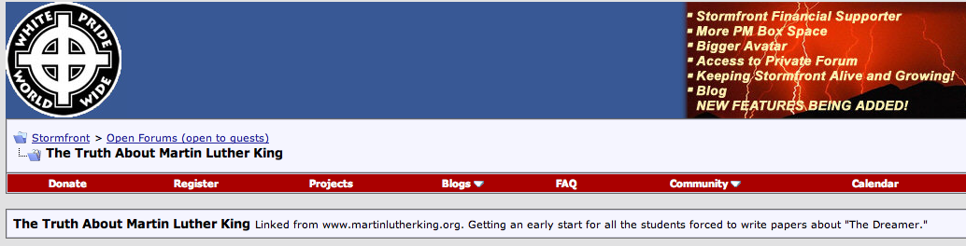

Slide 79


Slide 80
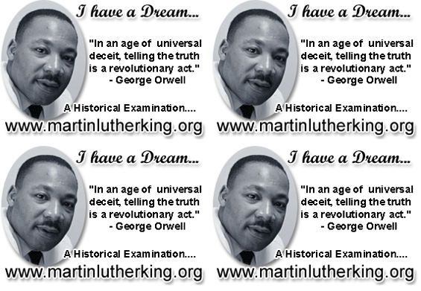

Slide 81
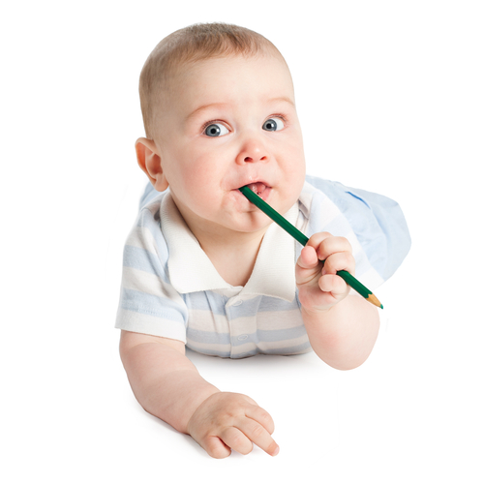
Demonstrate writing as a process – including planning
Teach depersonalisation & self-regulation
Allow oral rehearsal
Short & long sentences
Connectives

Slide 82
Know your connectives
Adding: and, also, as well as, moreover, too
Cause & effect: because, so, therefore, thus, consequently
Sequencing: next, then, first, finally, meanwhile, before, after
Qualifying: however, although, unless, except, if, as long as, apart from, yet
Emphasising: above all, in particular, especially, significantly, indeed, notably
Illustrating: for example, such as, for instance, as revealed by, in the case of
Comparing: equally, in the same way, similarly, likewise, as with, like
Contrasting: whereas, instead of, alternatively, otherwise, unlike, on the other hand

Slide 83
HOW?:
Making it Happen

Slide 84
3

Slide 85
Leading change
(10)

Slide 86
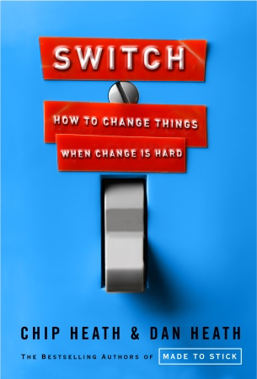
Directing the rider. Make sure the rider knows where to go, how others got there, and how you’ll get there.
Motivating the elephant. Knowing isn’t enough. Make sure the elephant feels drawn to the change. Make the change small (so it’s not intimidating) and encourage a growth mindset (“change is possible”).
Shaping the path. Change the environment to change the behavior. Build habits. Behavior is contagious: surround yourself with others exhibiting the behavior your want; help is spread.
And are you factoring in the influence of the rider, the elephant, and the environment?

Slide 88
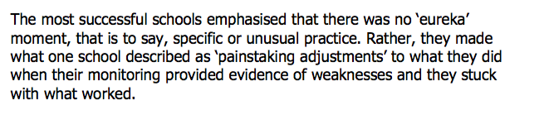

Slide 89
1: Is there a sense of mission around literacy?

Slide 90
The City Academy, Hackney:
The school has established a literacy policy with five strands that guide the work of all teachers.
Pupils in lessons should always speak in sentences.
There should be a consistent policy on marking and feedback (a ‘green pen’ approach).
Improving literacy in secondary schools: a shared responsibility April 2013, No. 120363
■ Pupils should always have a ‘book on every table’.
■ Teachers in all subjects should model writing for their pupils.
■ Pupils should be taught to organise their extended writing into well- structured paragraphs.

Slide 91
In mathematics and science lessons observed by inspectors, there was considerable emphasis on pupils explaining their answers in detail. Teachers modelled the appropriate language, for example:
In full sentences, please. ‘In the first place, we should get rid of fractions and then...’
Can you explain that in a full sentence? ‘I know that magnesium is more reactive than copper because...’
Marking in all subjects has a literacy focus, as do success criteria and learning objectives. For example, in a very effective history lesson observed by inspectors, there was an explicit expectation that pupils would answer using full sentences. There was an equally explicit and shared expectation that pupils’ writing would be carefully structured, using paragraphs, capital letters and full stops.

Slide 92
2: Who are your key players … and what are they doing?

Slide 93
Literacy Impact: The next phase
Key player | Progress rating | Priority
Head
You
Librarian
Teachers
Teaching assistants
Governors

Slide 94
3: What are the literacy non-negotiables in teaching?

Slide 95
Essential literacy rooted in professional development
An example …

Slide 96
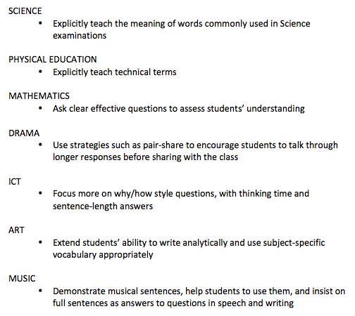
Literacy Promises

Slide 97
4: Where is literacy in induction, CPD, research?

Slide 98
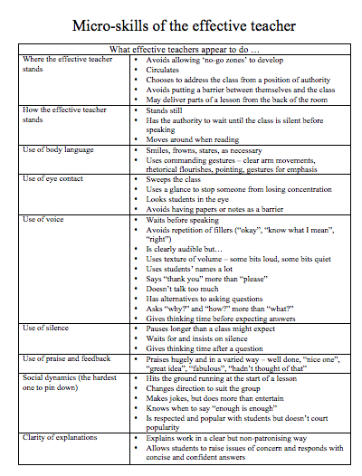

Slide 99
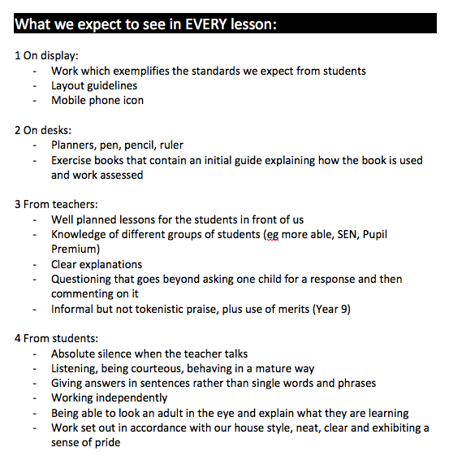

Slide 100


Slide 101
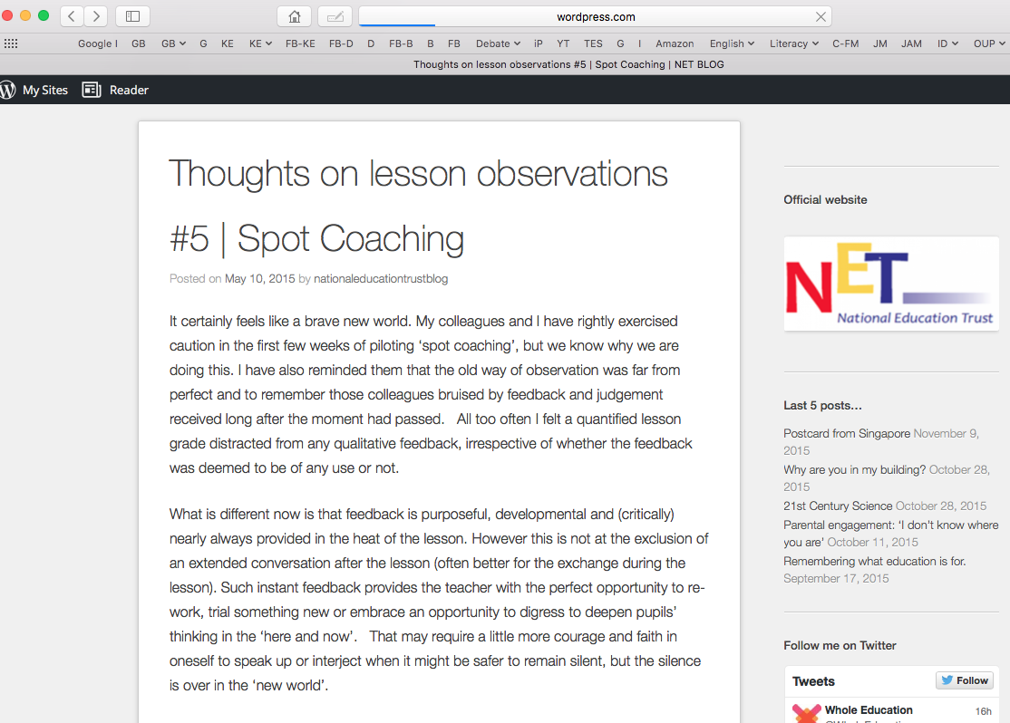

Slide 102
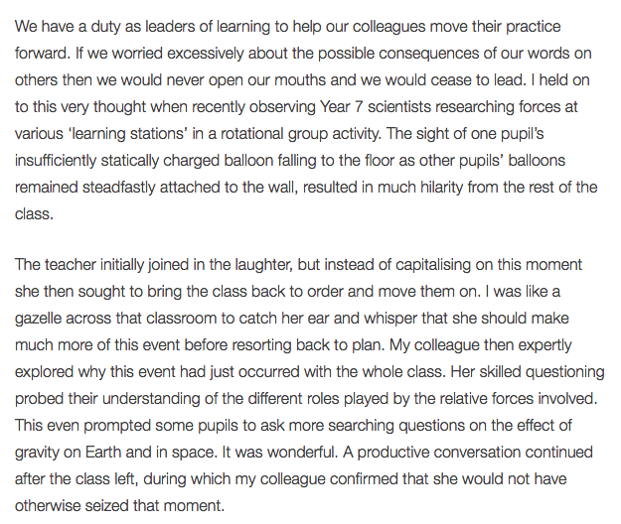

Slide 103
Keith Grainger: Spot Coaching
I am left in no doubt that immediate feedback, in the same way that a tennis coach or dance instructor provides, has powerful potential as a professional development tool in teaching. Our recent work has been exhilarating. I hope never to grade a single lesson again.

Slide 104
5: What’s the whole-school approach to speaking & listening?

Slide 105
Understand the significance of exploratory talk
Build extended responses & public speaking
Model good talk – eg connectives
Consciously vary groupings
Re-think questioning – ‘why & how’, thinking time, and kill fatuous praise

Slide 106
6: Who is teaching reading? What’s the reading culture like?

Slide 107
Teach and model reading
Personalise reading
Teach key vocabulary
Demystify spelling
Teach research, not FOFO

Slide 108
On Reading:
Teenagers who read books are significantly more likely to end up in a professional job than those who don’t (survey of 17,000 people born in 1970).
Three in 10 young people aged 8 to 17 love in households without any books (Indy, in the Week, 11/6/11)
Studies also show that reading a variety of literature independently by the age of 15 is the single biggest indicator of future success, outweighing negative factors such as socioeconomic background or family situation. NLT April 2011
One in three children in UK does not own a book. NLT April 2011

Slide 109
7: How is vocabulary being built?

Slide 110
8: How is spelling being demythologised?

Slide 111

DEMYSTIFYING
SPELLING
3
Notes:
7 spellings: Government – February – parliament – separate – believe – necessary - accommodation

Slide 112
1 - SOUNDS

Slide 113
Government

Slide 114
February

Slide 115
Parliament

Slide 116
2 -VISUALS

Slide 117
Se-para-te
Be-lie-ve

Slide 118
3 - MNEMONICS

Slide 119
necessary

Slide 120
accommodation

Slide 121
9: How is writing being taught – esp depersonalisation?

Slide 122
Demonstrate writing as a process – including planning
Teach depersonalisation & self-regulation
Allow oral rehearsal
Short & long sentences
Connectives

Slide 123
Know your connectives
Adding: and, also, as well as, moreover, too
Cause & effect: because, so, therefore, thus, consequently
Sequencing: next, then, first, finally, meanwhile, before, after
Qualifying: however, although, unless, except, if, as long as, apart from, yet
Emphasising: above all, in particular, especially, significantly, indeed, notably
Illustrating: for example, such as, for instance, as revealed by, in the case of
Comparing: equally, in the same way, similarly, likewise, as with, like
Contrasting: whereas, instead of, alternatively, otherwise, unlike, on the other hand

Slide 124
10: How do we know whether any of this is having an impact?

Slide 125
Literacy Impact: The next phase
Key player | Progress rating | Priority
Head
You
Librarian
Teachers
Teaching assistants
Governors
Students

Slide 126
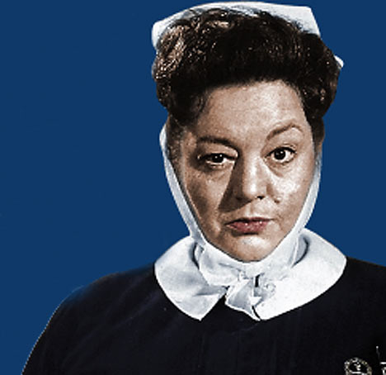
Leadership Surgery

Slide 127
A: You lead a book scrutiny. Teacher A’s books are badly marked. She is an Assistant Head. What do you do?
B: Students tell you that Teacher B talks all the time and is really boring. His results are excellent. What do you do?
C: Teacher C says publicly in a staff meeting that literacy is none of his business. What do you do?
Notes:
1 accommodation; 2 necessary; 3 separate; 4 fulfil; 5 they’re

Slide 128
D: Your Head shows no interest in literacy, or pedagogy. He doesn’t engage with you or other staff on whole-school strategy.
What do you do, if anything?
Notes:
1 accommodation; 2 necessary; 3 separate; 4 fulfil; 5 they’re

Slide 129
What were you hoping to get out of today?
Notes:
1 accommodation; 2 necessary; 3 separate; 4 fulfil; 5 they’re

Slide 130
What 3 things will you now do?
(Guaranteed)
(Promise)
No excuses)
Notes:
1 accommodation; 2 necessary; 3 separate; 4 fulfil; 5 they’re

Slide 131

So ..
Restate the mission
If literacy is a priority, do something
Customise and simplify ruthlessly across key players
Use TAs and students for constant feedback
Build into school systems of training, observation, appraisal, evaluation

Slide 132
Outstanding Leadership of Literacy
Geoff Barton
Head, King Edward VI School
Suffolk
Teachology
2 March 2017
Twitter: @RealGeoffBarton
Presentation free at: geoffbarton.co.uk/teacher-resources (number 146)

Slide 133

Easter gift
idea ➔

